Slide 1


Machine Learning Project
By: Eric Ye
Instructor: Gitimoni Saikia
January 26, 2021
Metro College of Technology

Slide 2
Dataset 1: California housing dataset
Based on median house prices for each district from the 1990 census
Used to predict house prices based on a number of factors
20641 observations, 10 variables
GOAL: Identify the variables which affect house prices the most, and find which model is best and the most accurate when predicting house prices

Slide 3
variables
Longitude: measure of how far west a house is; a higher value is farther west
Latitude: measure of how far north a house is; higher value is farther north
houseMedianAge: Median age of a house within a block
totalRooms: Total number of rooms within a block
totalBedrooms: Total number of bedrooms within a block
Population: Total number of people residing within a block
Households: total number of households in a block
MedianIncome: Median income for households within a block
MedianHouseValue: Median price for the households within a block
OceanProximity: Location of the house w.r.t. ocean/sea

Slide 4
steps
Data cleaning/ preprocessing
Split data into train/ test/ validation set
Model building
Tune parameters
R-sq, adjusted R-sq, RMSE, MSE, scores
Conclusions

Slide 5
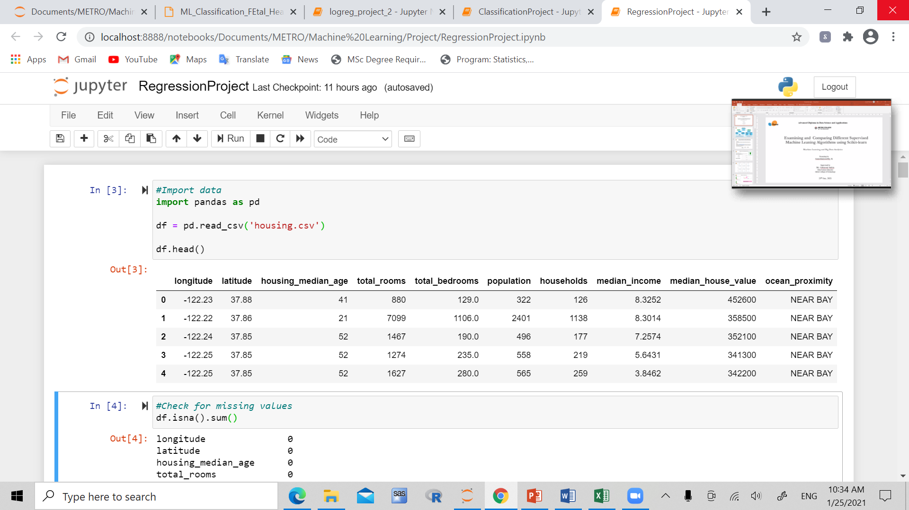
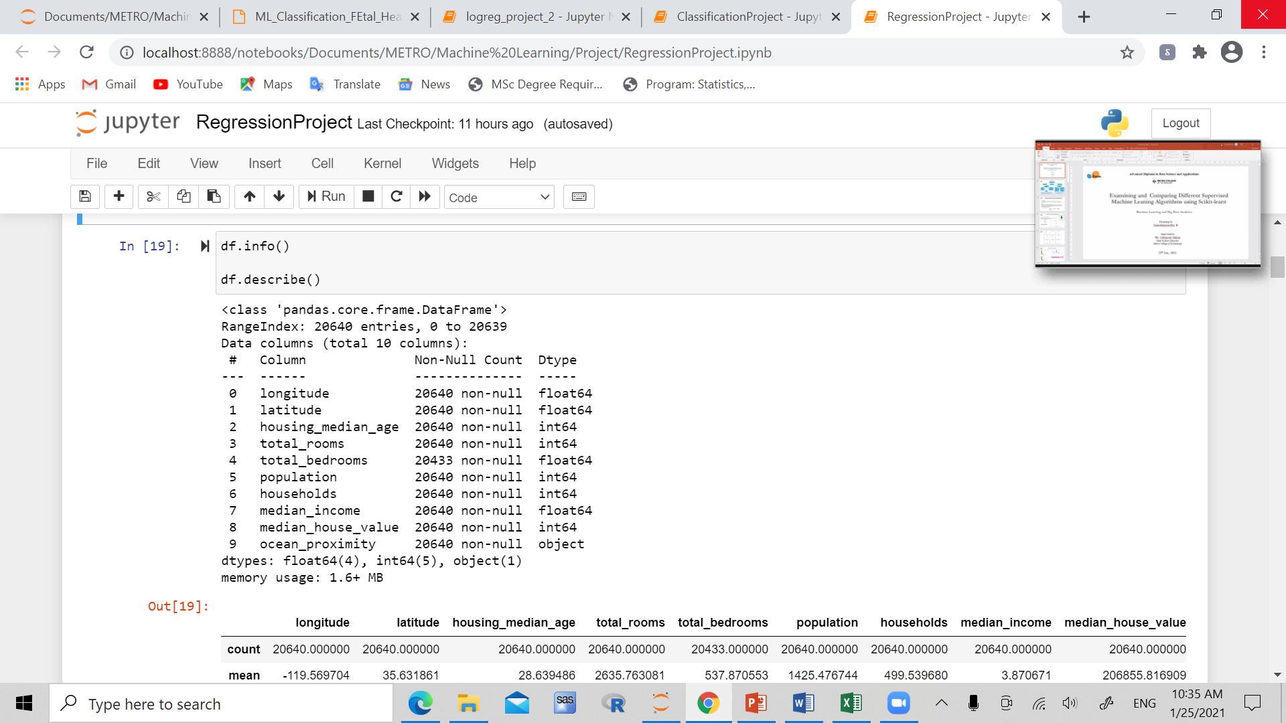
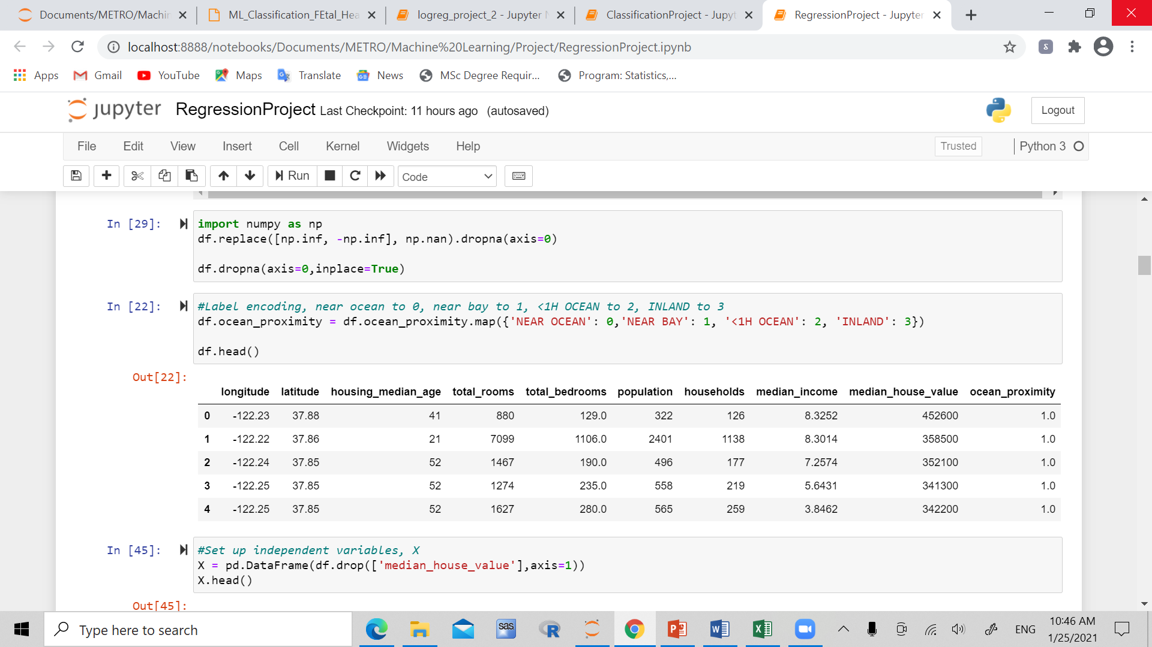
Cleaning/ Preprocessing

Slide 6
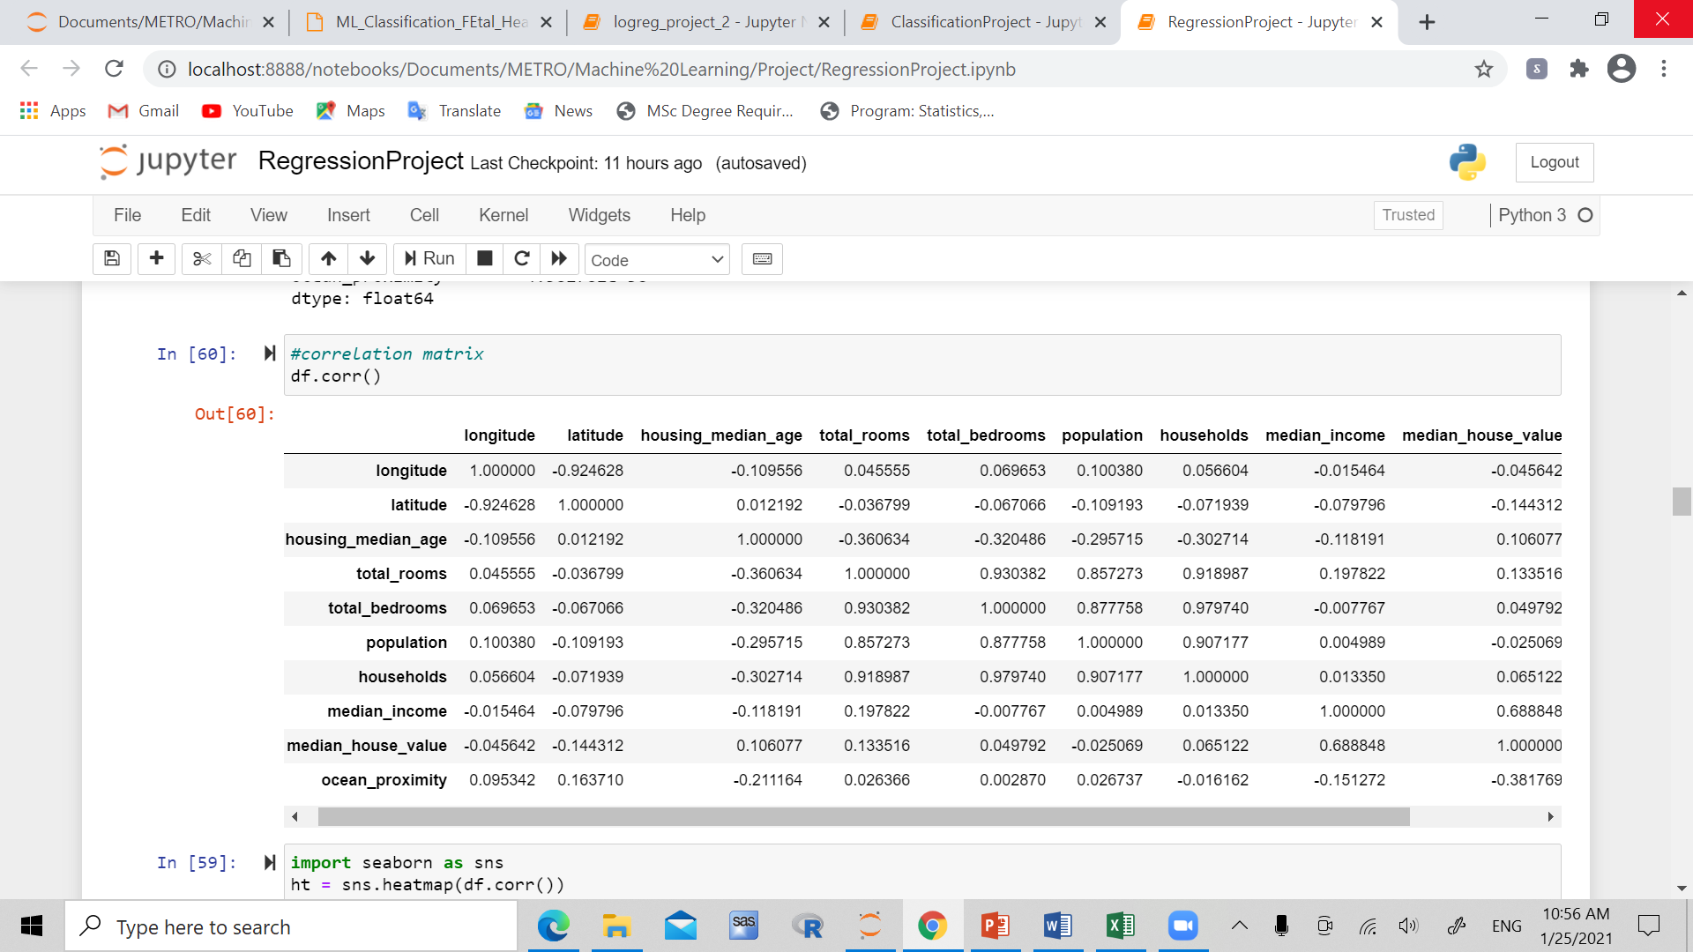
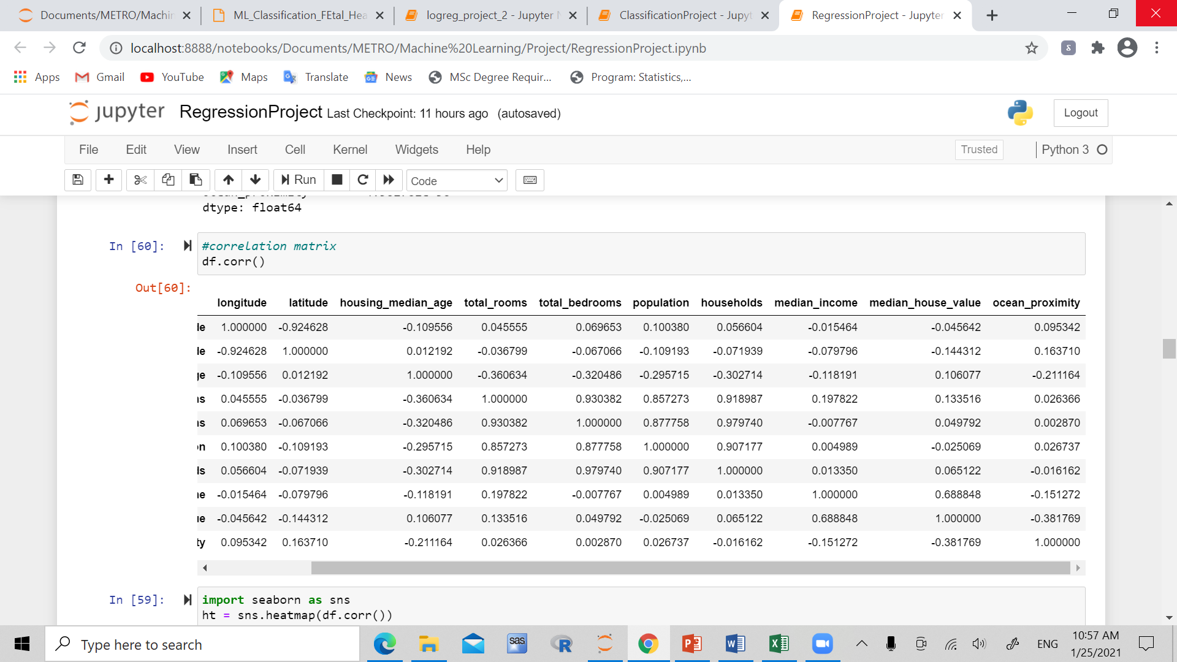
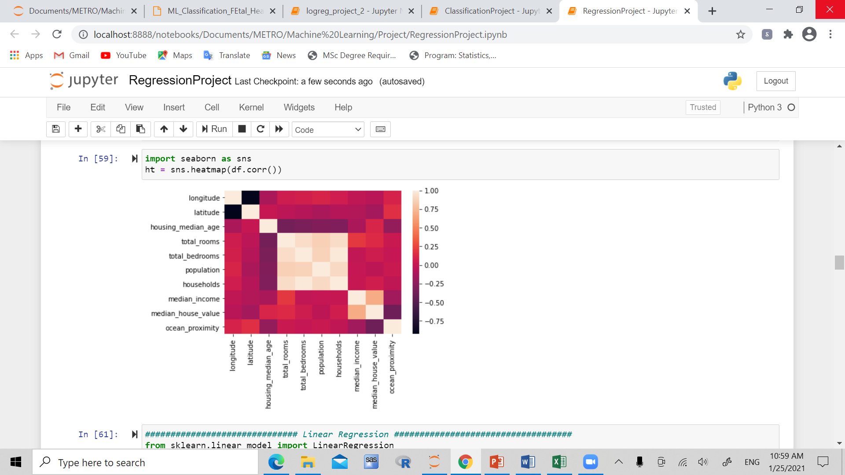

Slide 7
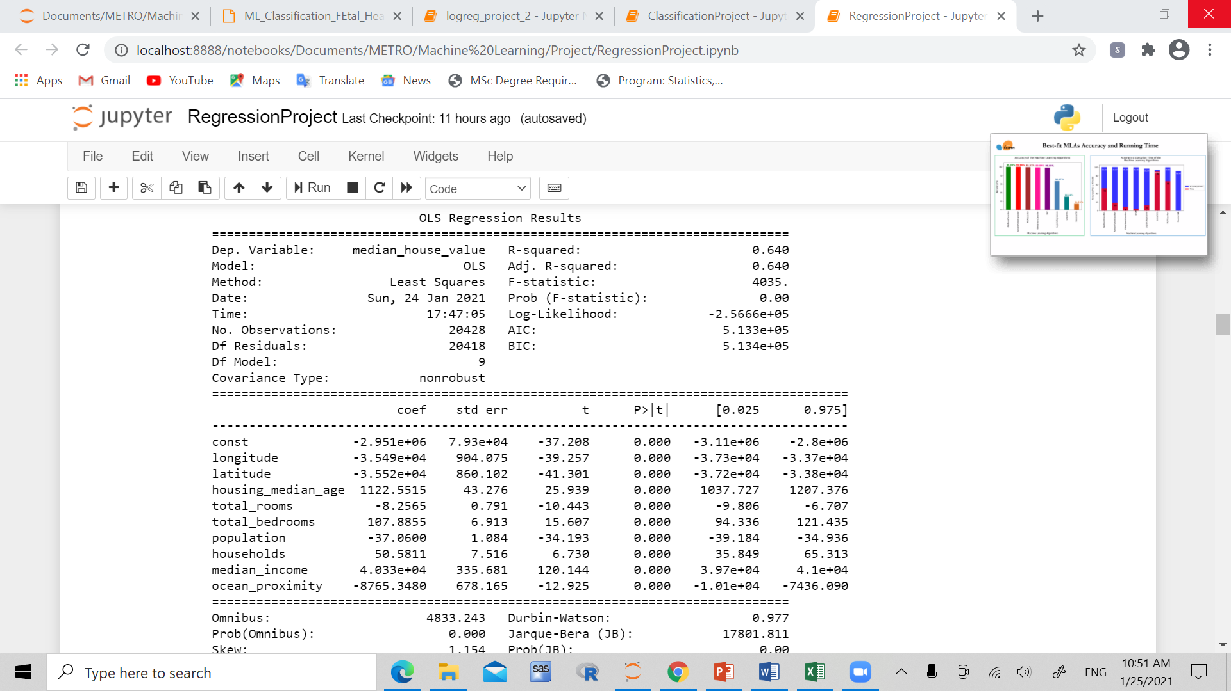
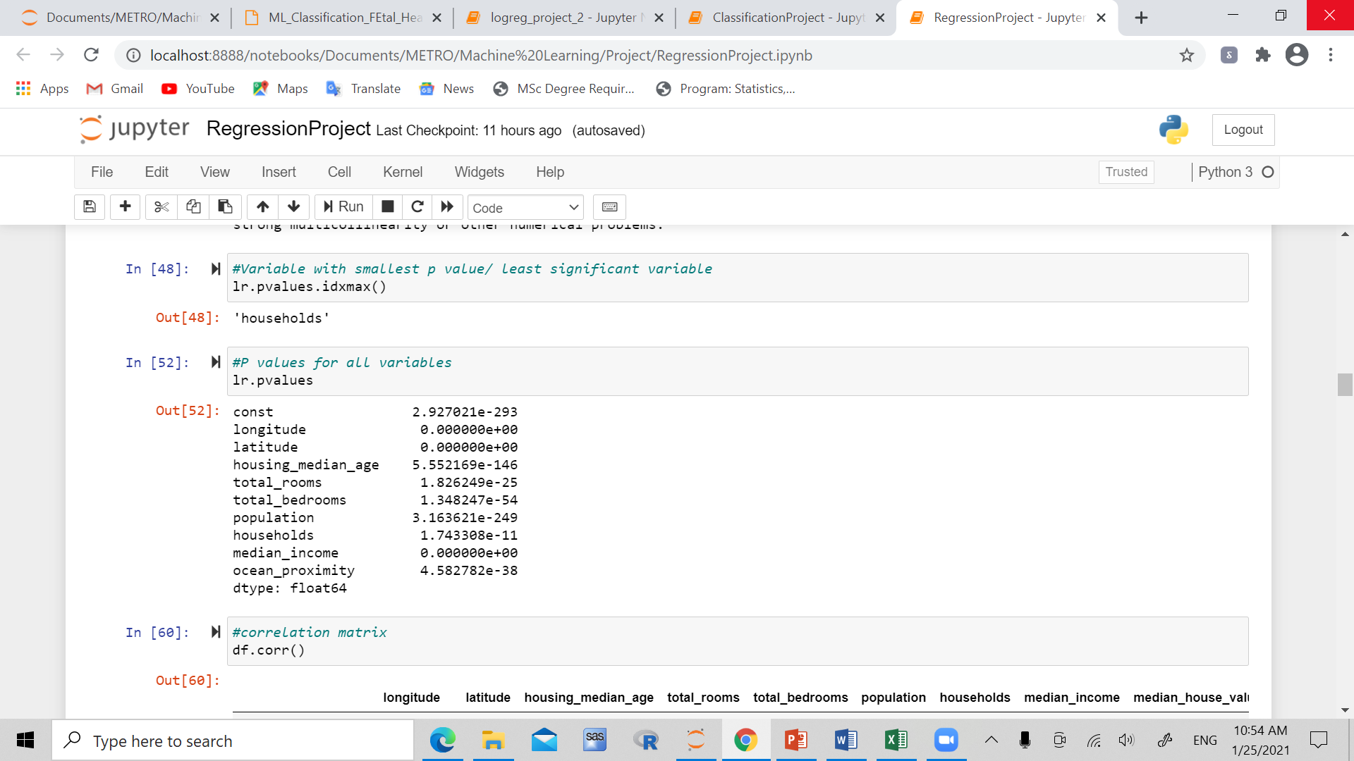
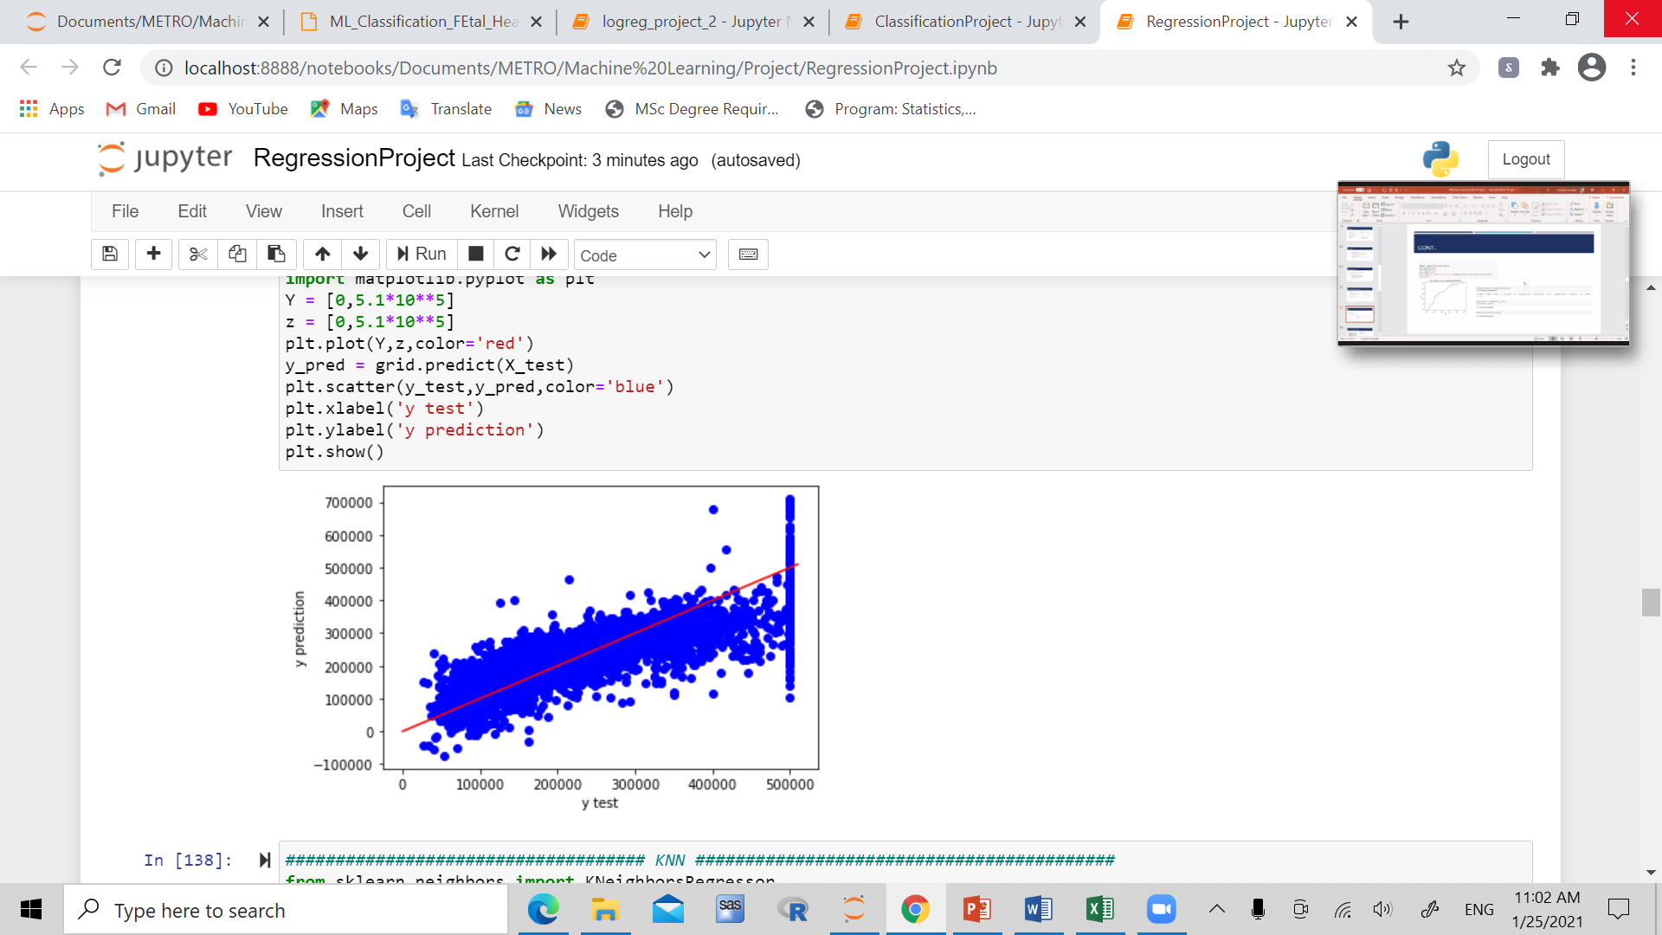
Linear regression

Slide 8
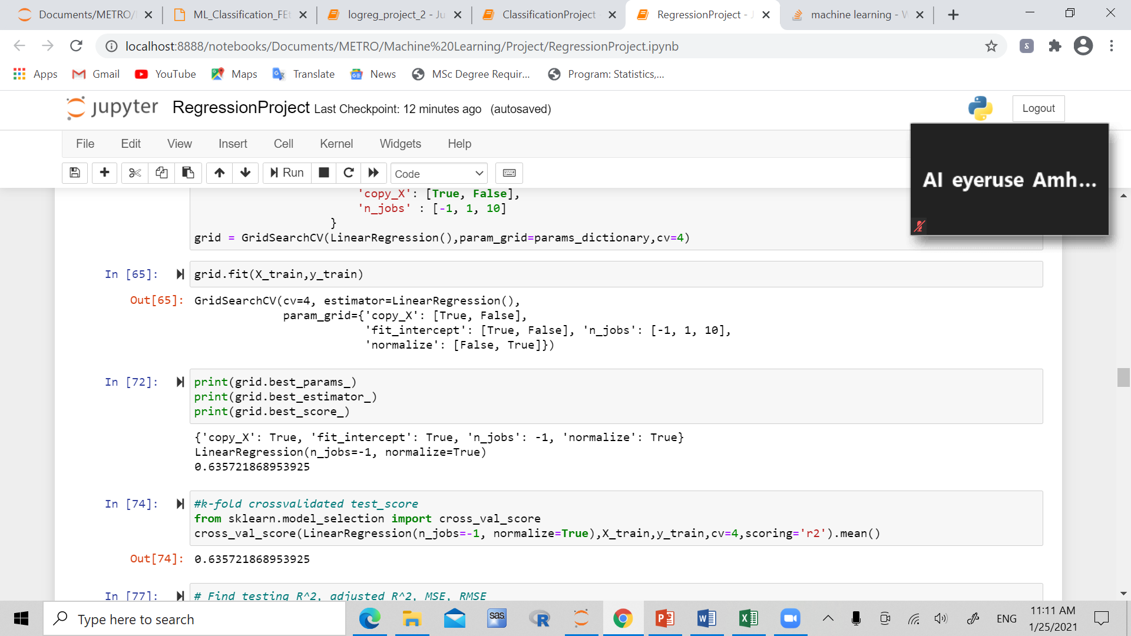
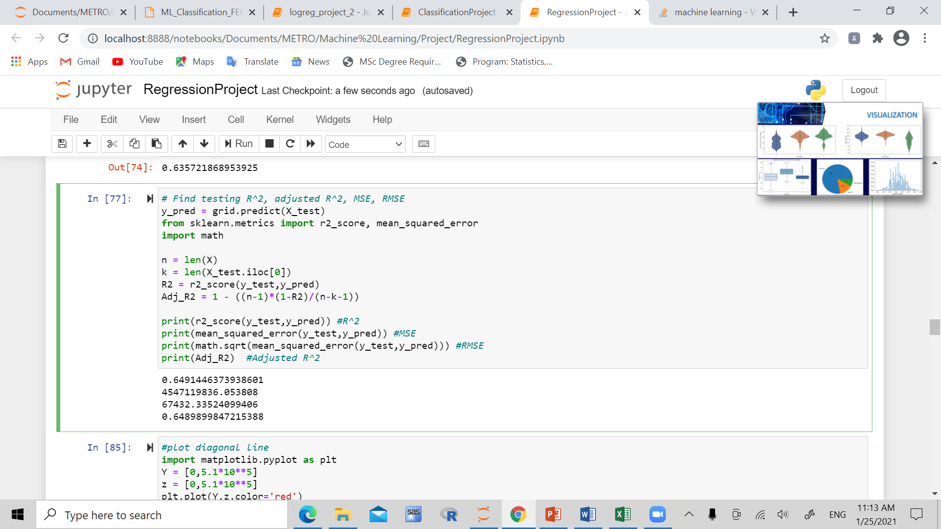
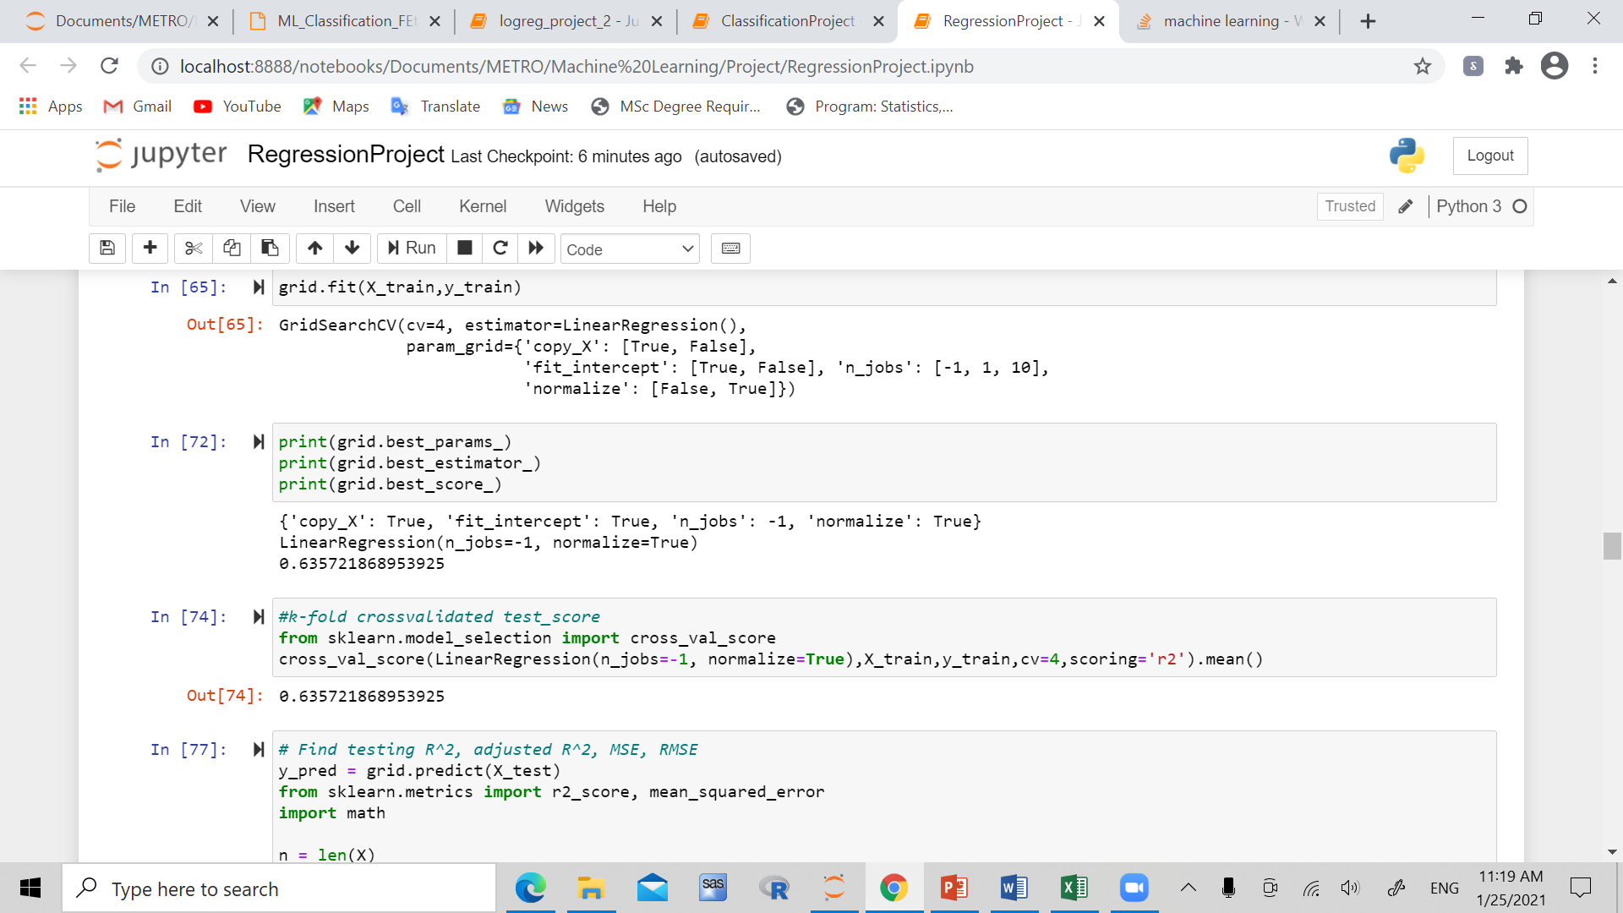

Slide 9
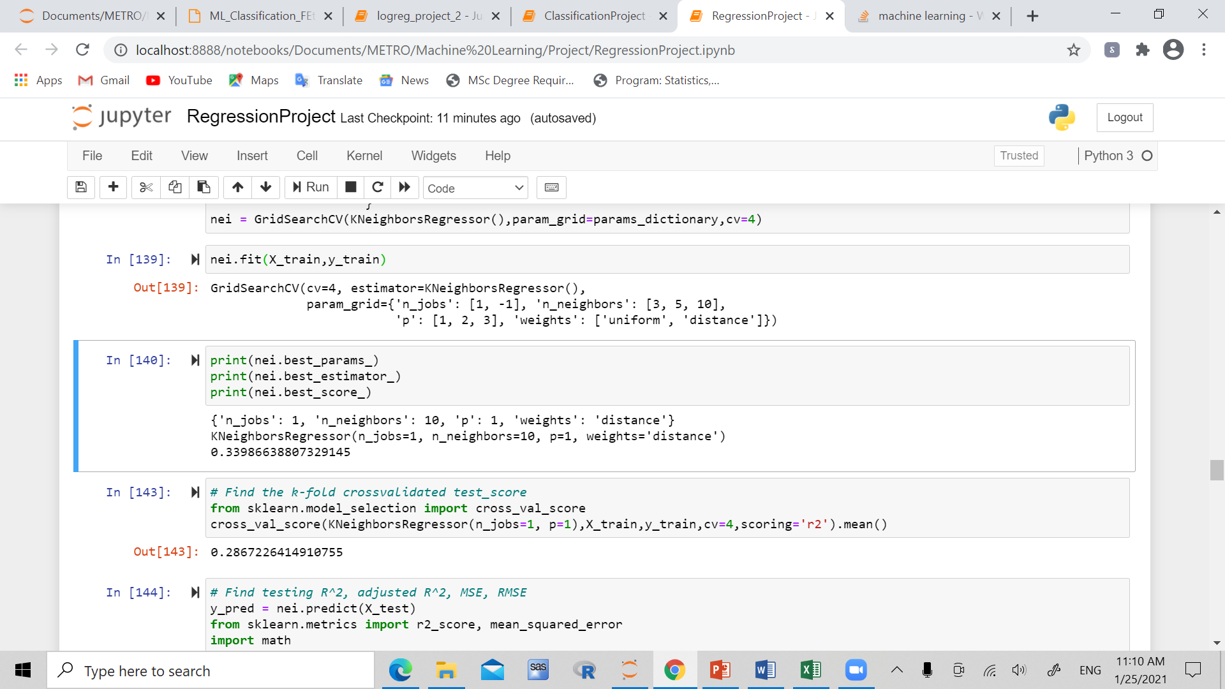
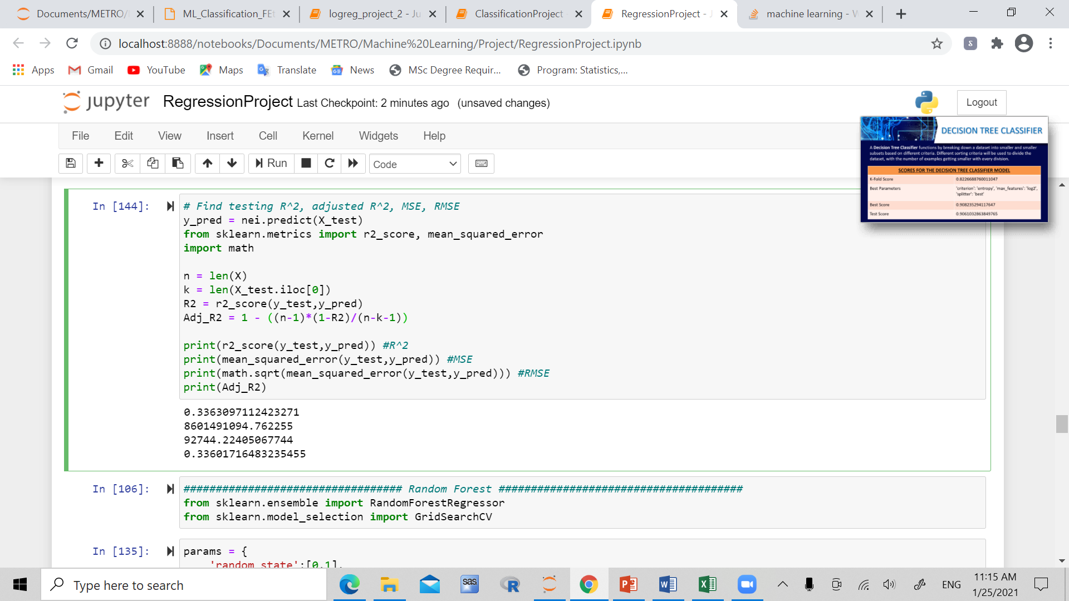
KNN method

Slide 10
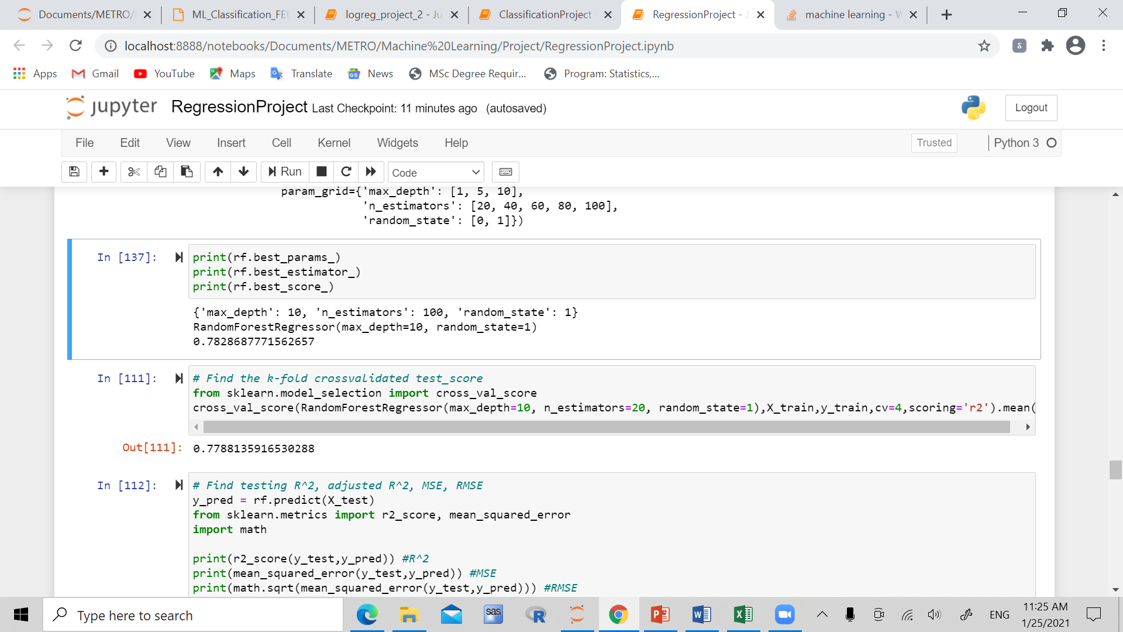
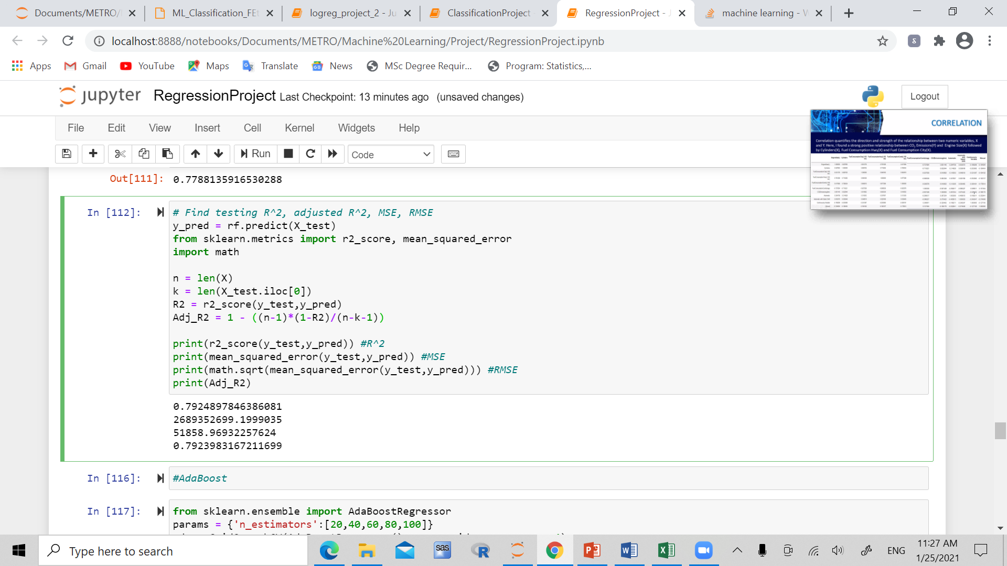
Random Forest

Slide 11
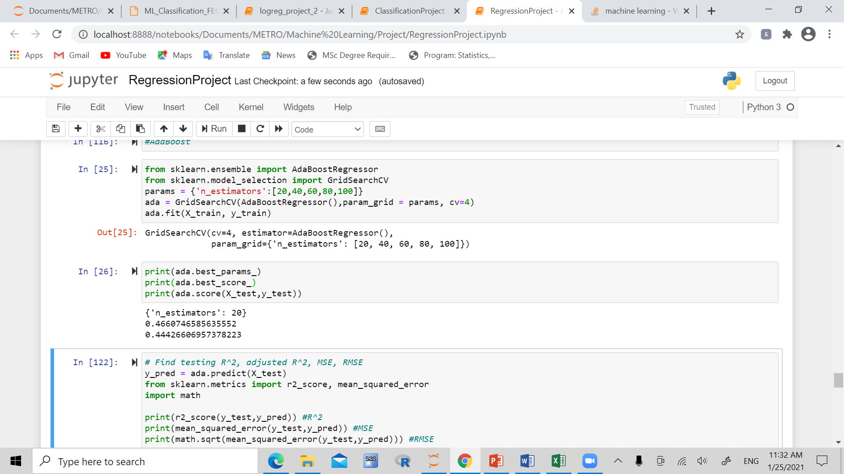
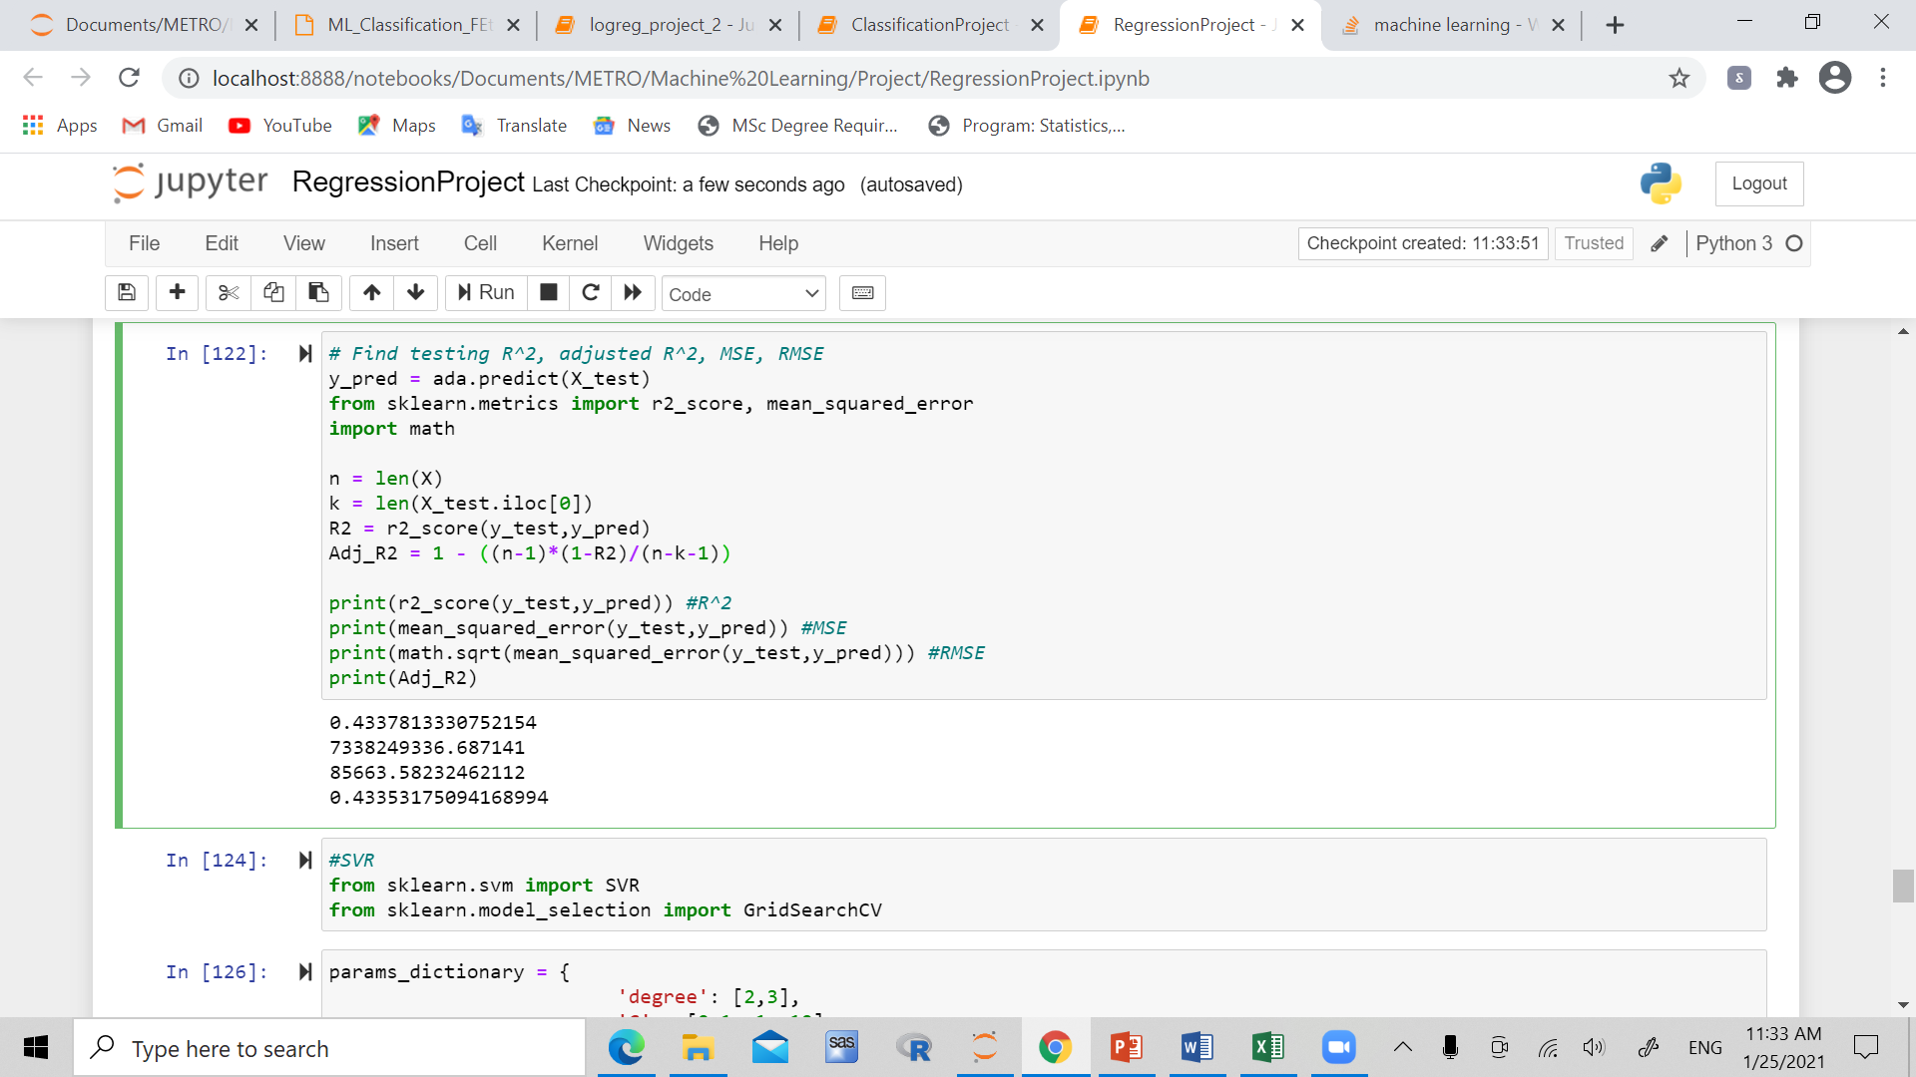
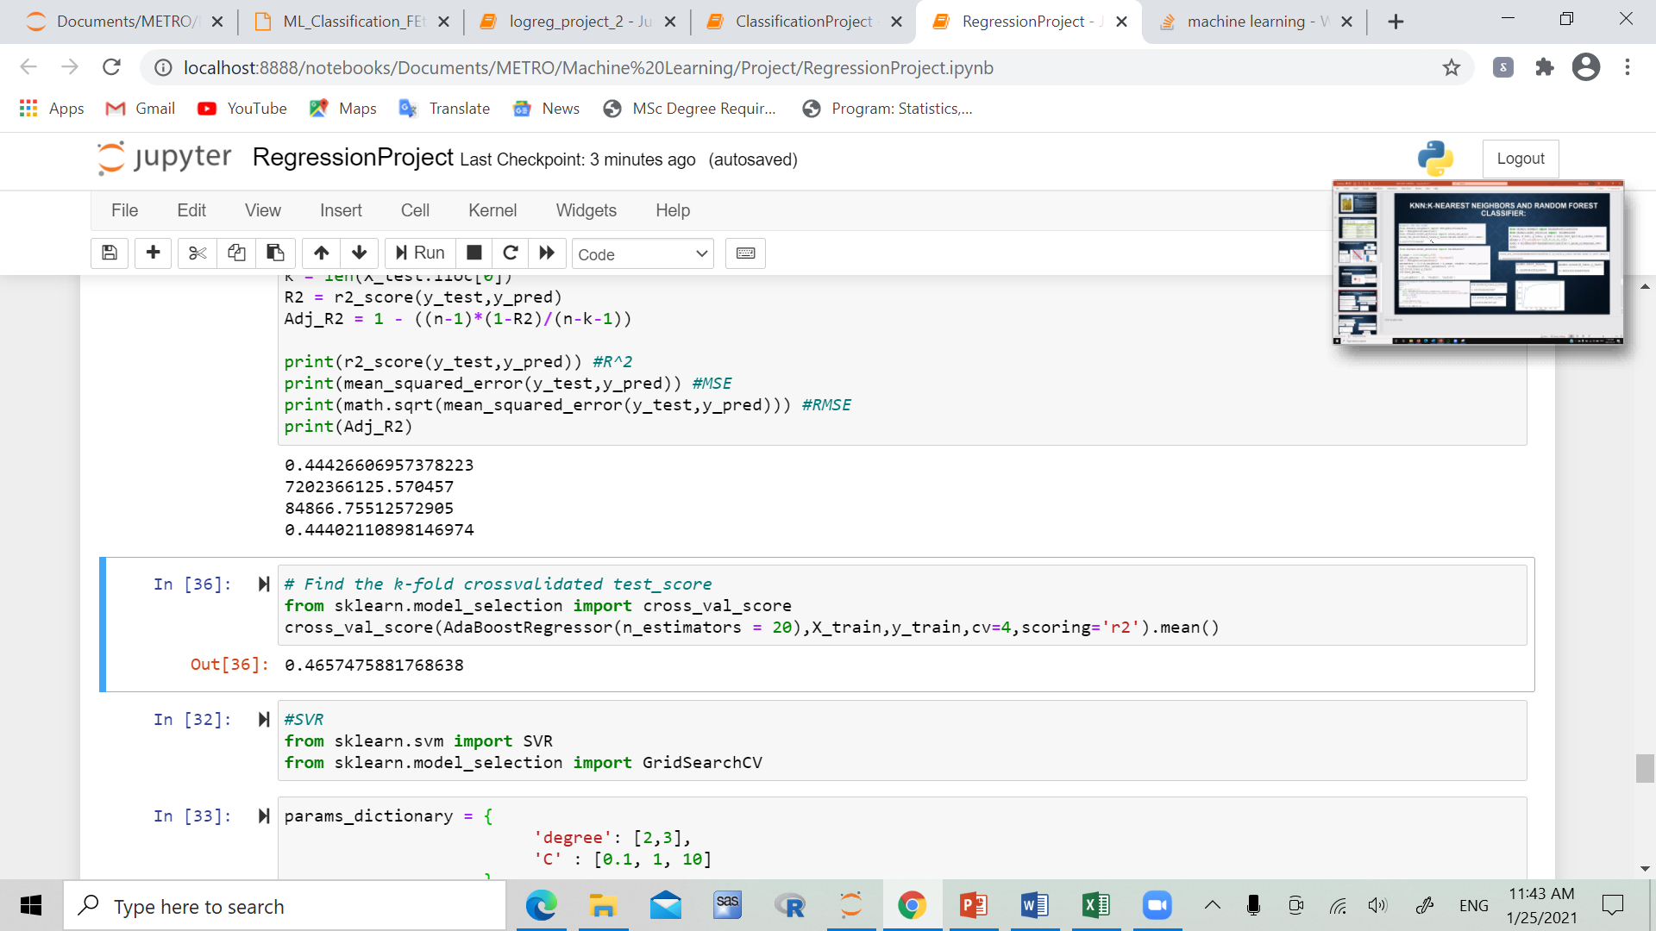
adaboost

Slide 12
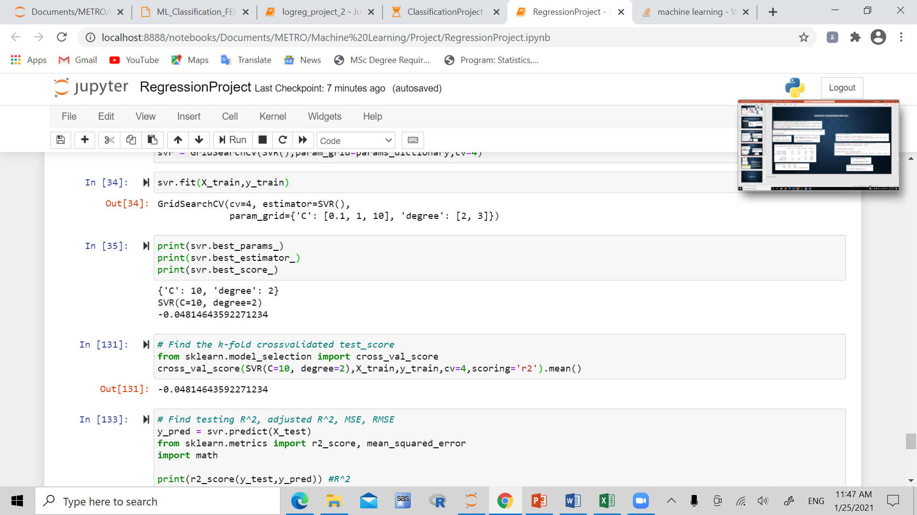
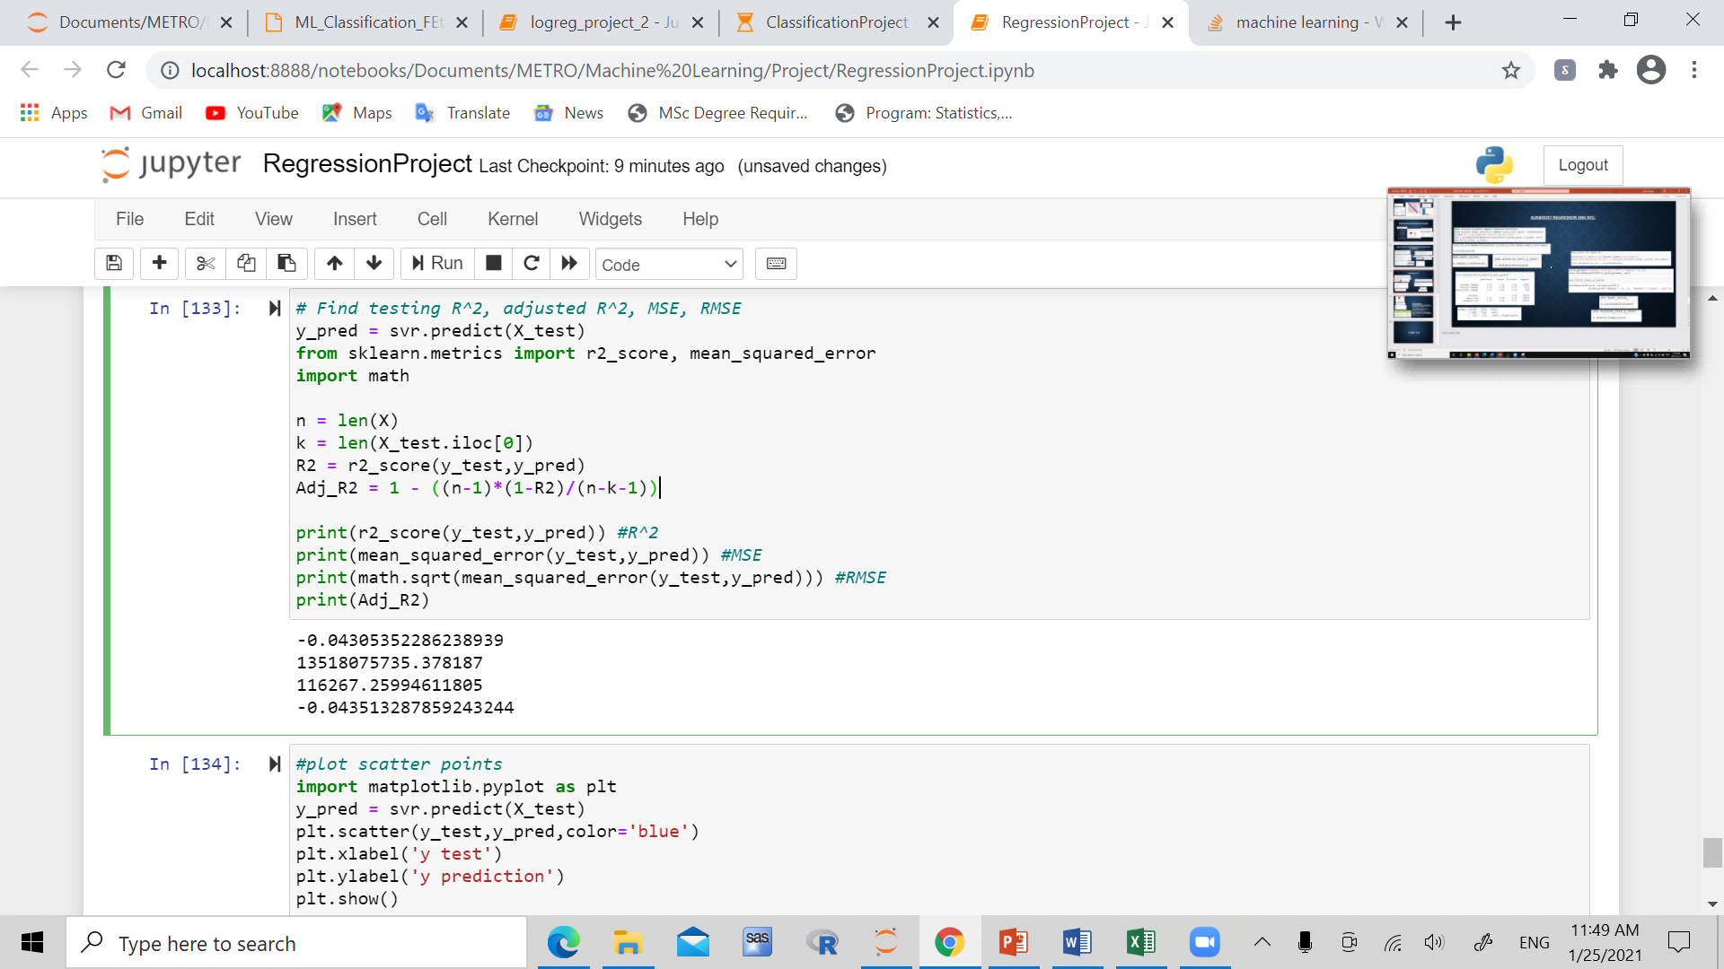
SVR (support vector regression)

Slide 13
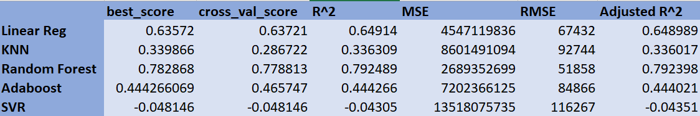
CONclusion
Best model to use would be random forest model

Slide 14
Dataset 2: job change of data scientists
Based on company which is active in Big Data and Data Science, who want to hire data scientists
The company conducts courses among people who successfully pass them, and want to study whether or not these people really want to work for the company, or leave for other jobs based on certain factors
19159 observations, 14 variables
GOAL: find the model which makes the best prediction of the targeted variable

Slide 15
Variables
City: city_code
City_development_index
Gender
Relevant experience
Enrolled university
Education level: education level of candidate
Major discipline
Experience: Candidate experience in years
Company size: # of employees in current employer’s company
Company type
Last new job: difference in years between last job and current job
Training hours: # of training hours completed
Target: 0 – Not looking for job change, 1- looking to change jobs

Slide 16
STEPs
Data cleaning/ preprocessing
Split data into train/ test/ validation set
Model building
Tune hype parameters
Evaluate on validation set
Final model selection

Slide 17
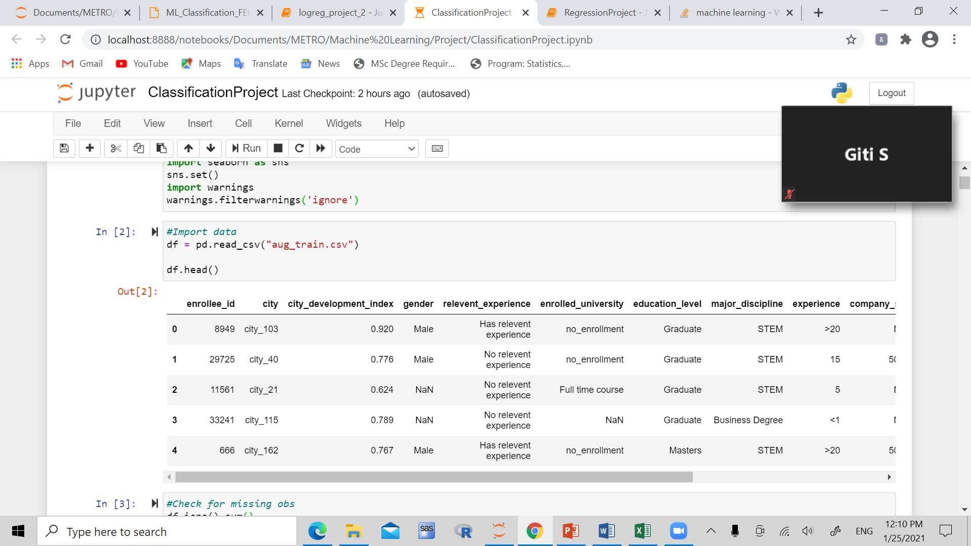
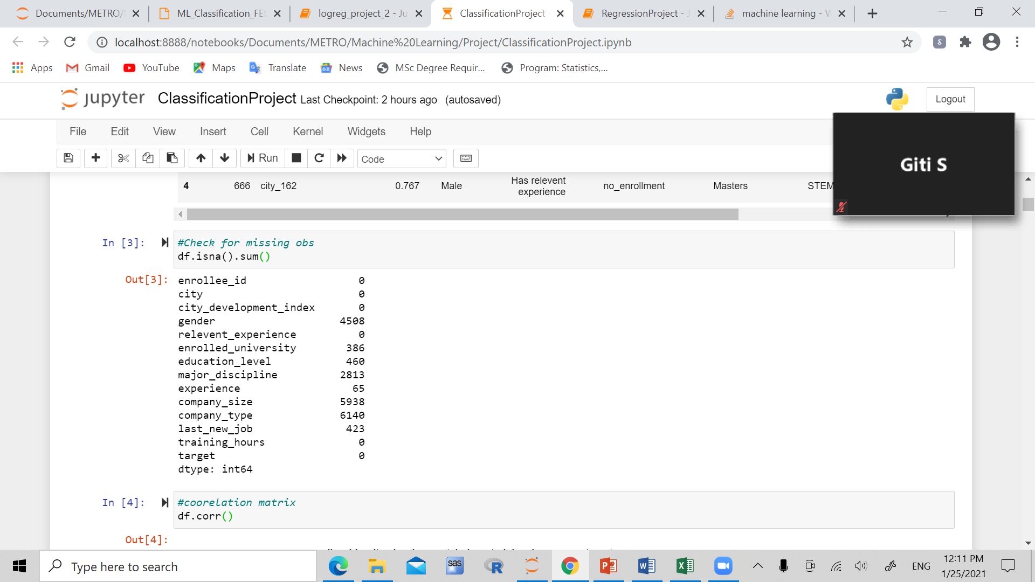
Data cleaning/ preprocessing

Slide 18
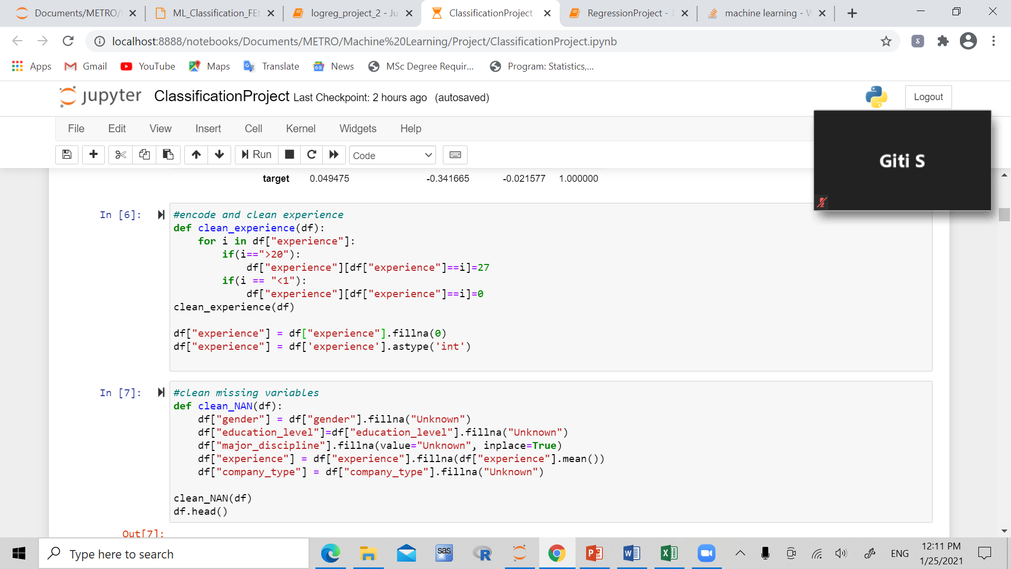
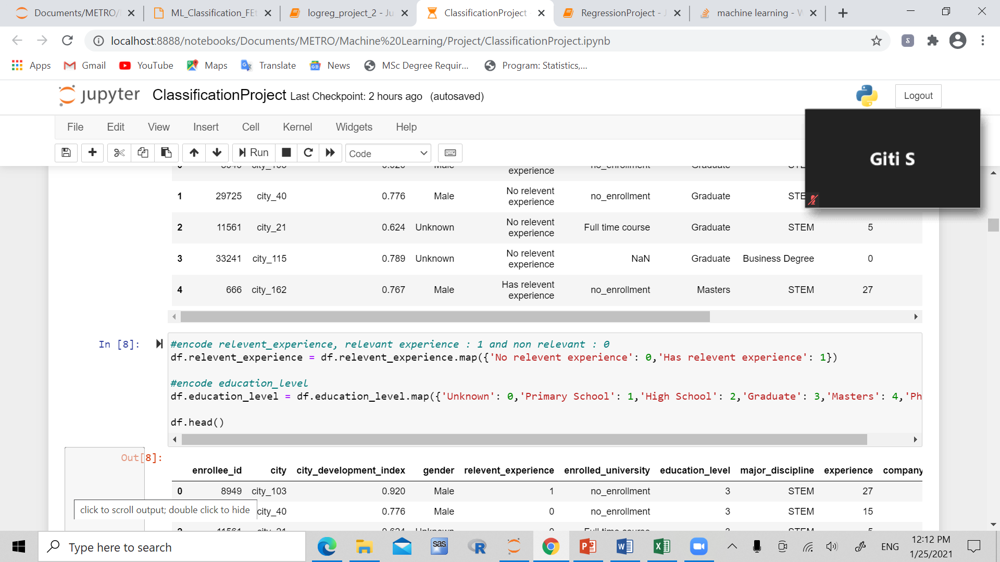

Slide 19
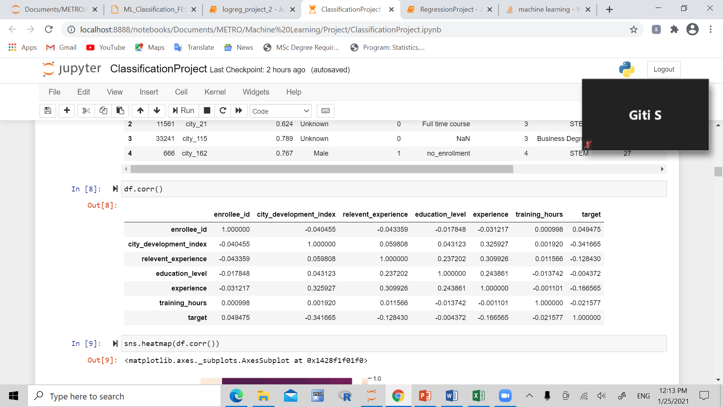
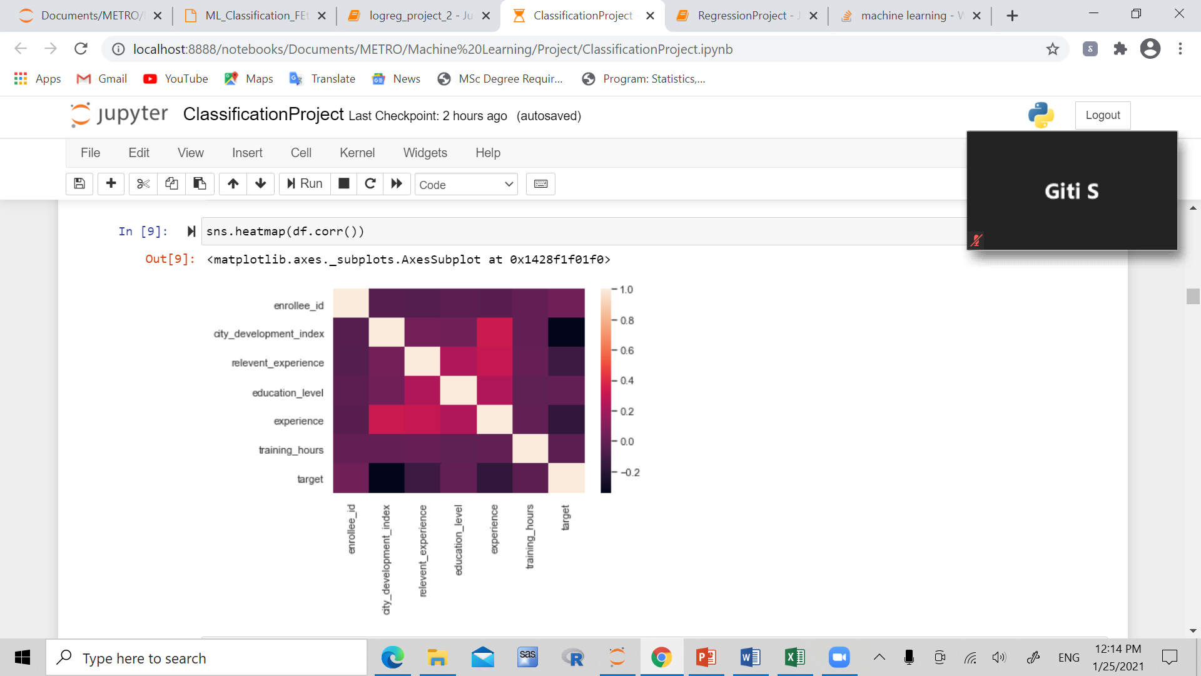

Slide 20
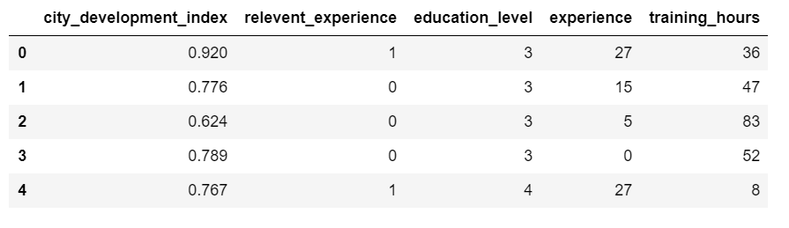

Slide 21
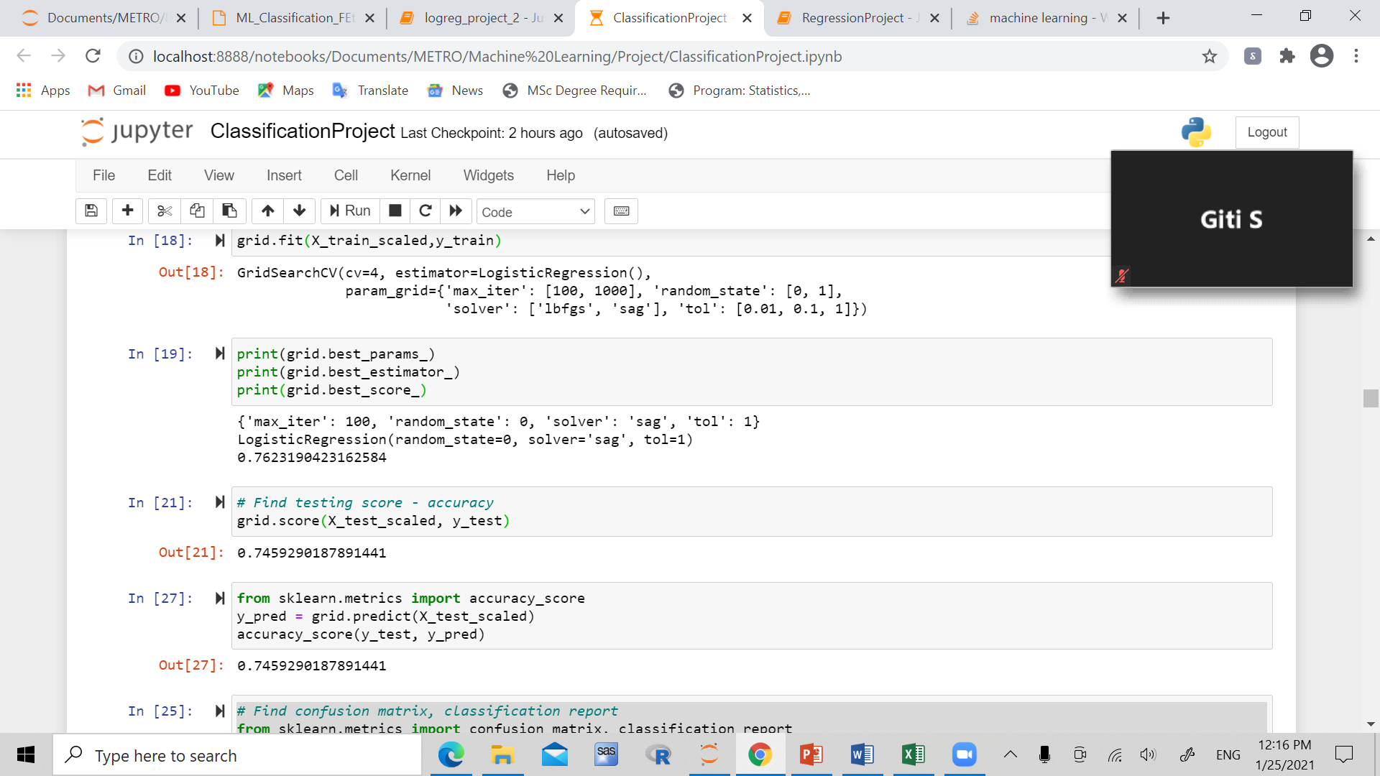
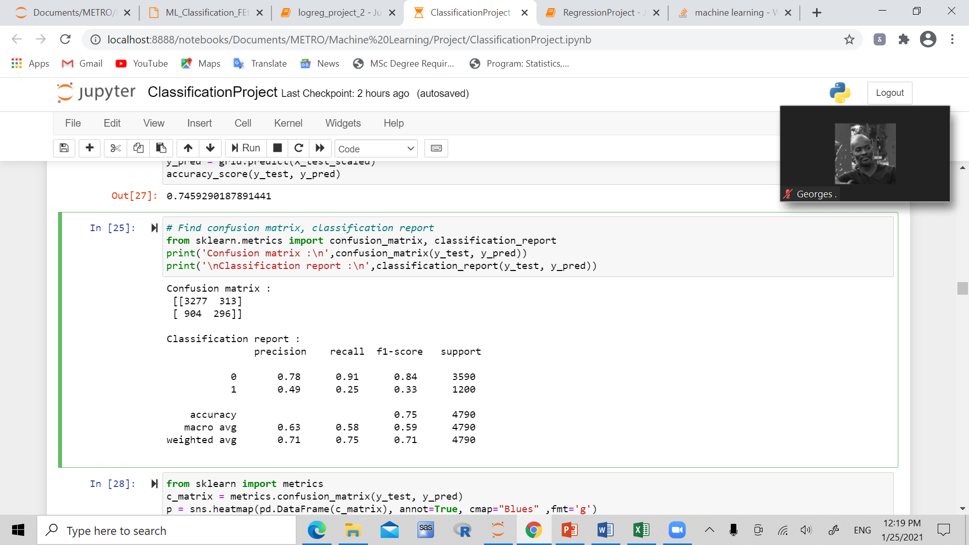
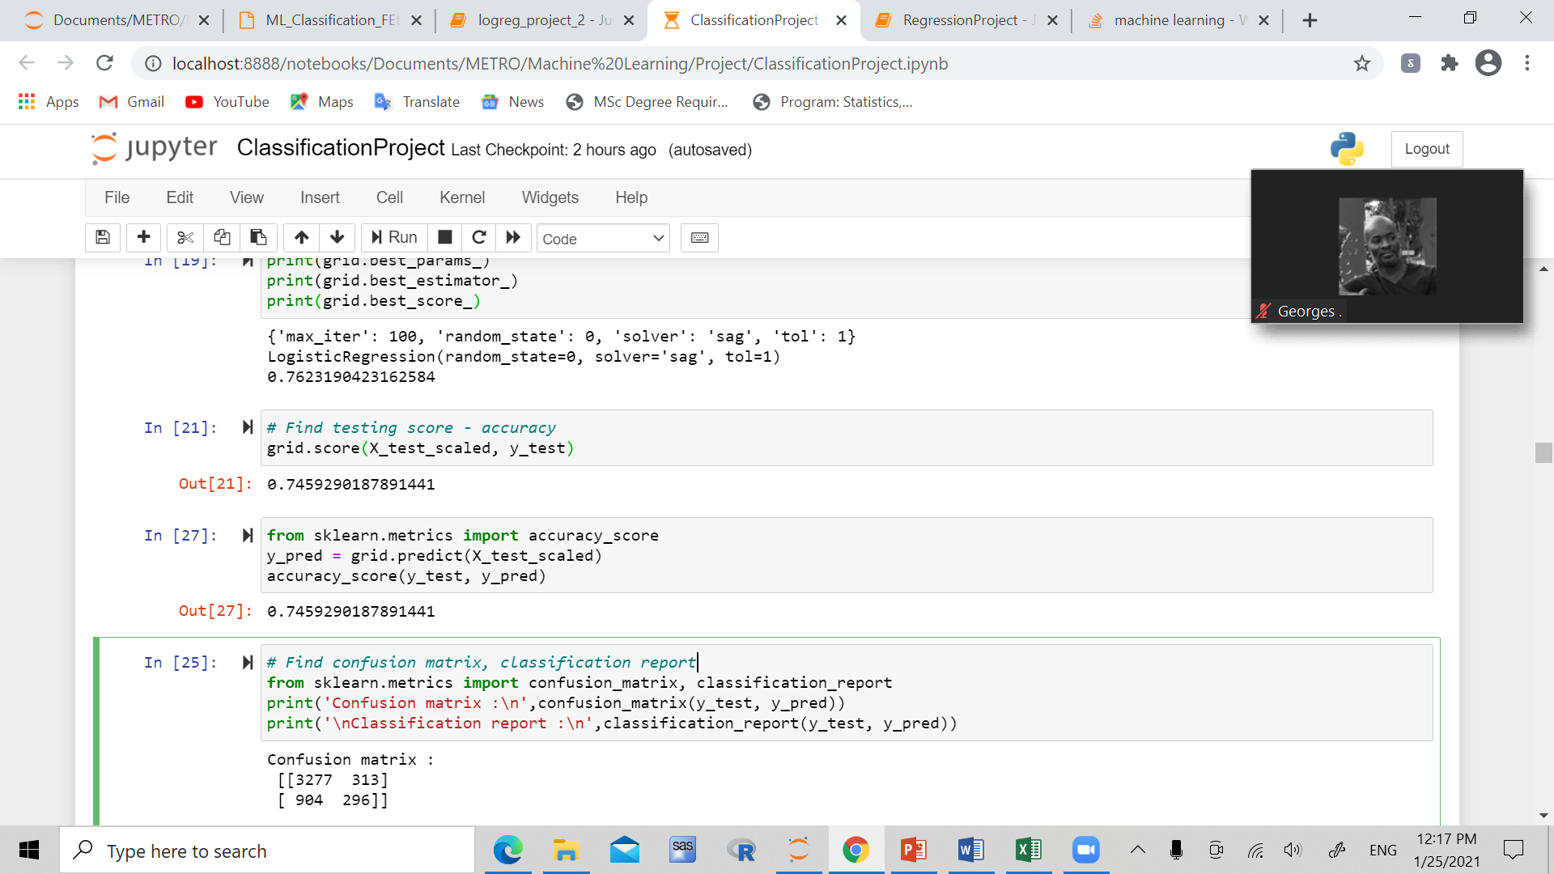
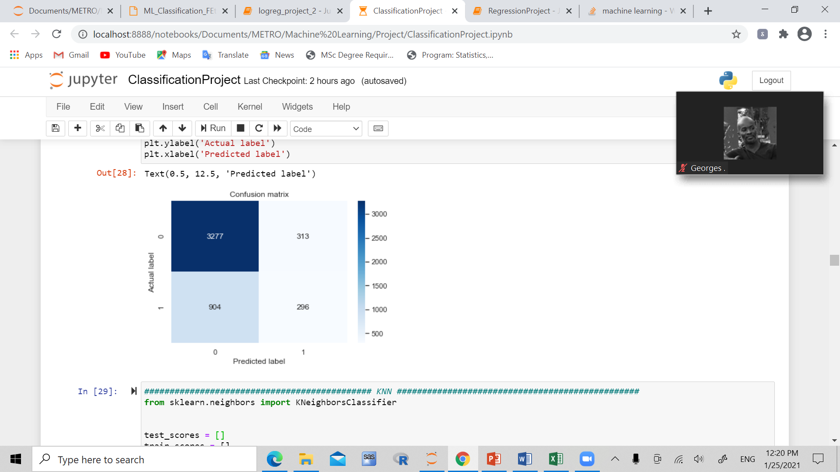
Logistic regression

Slide 22
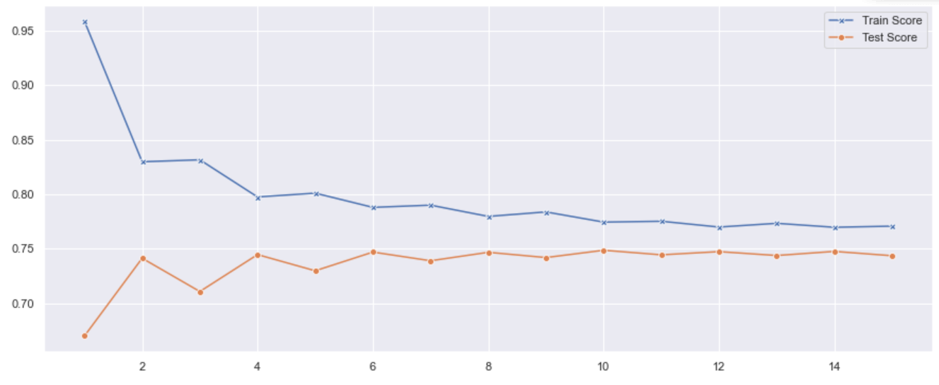
Knn (k nearest neighbours)
Best test score result is at 10, so we used k=10 for the final model

Slide 23
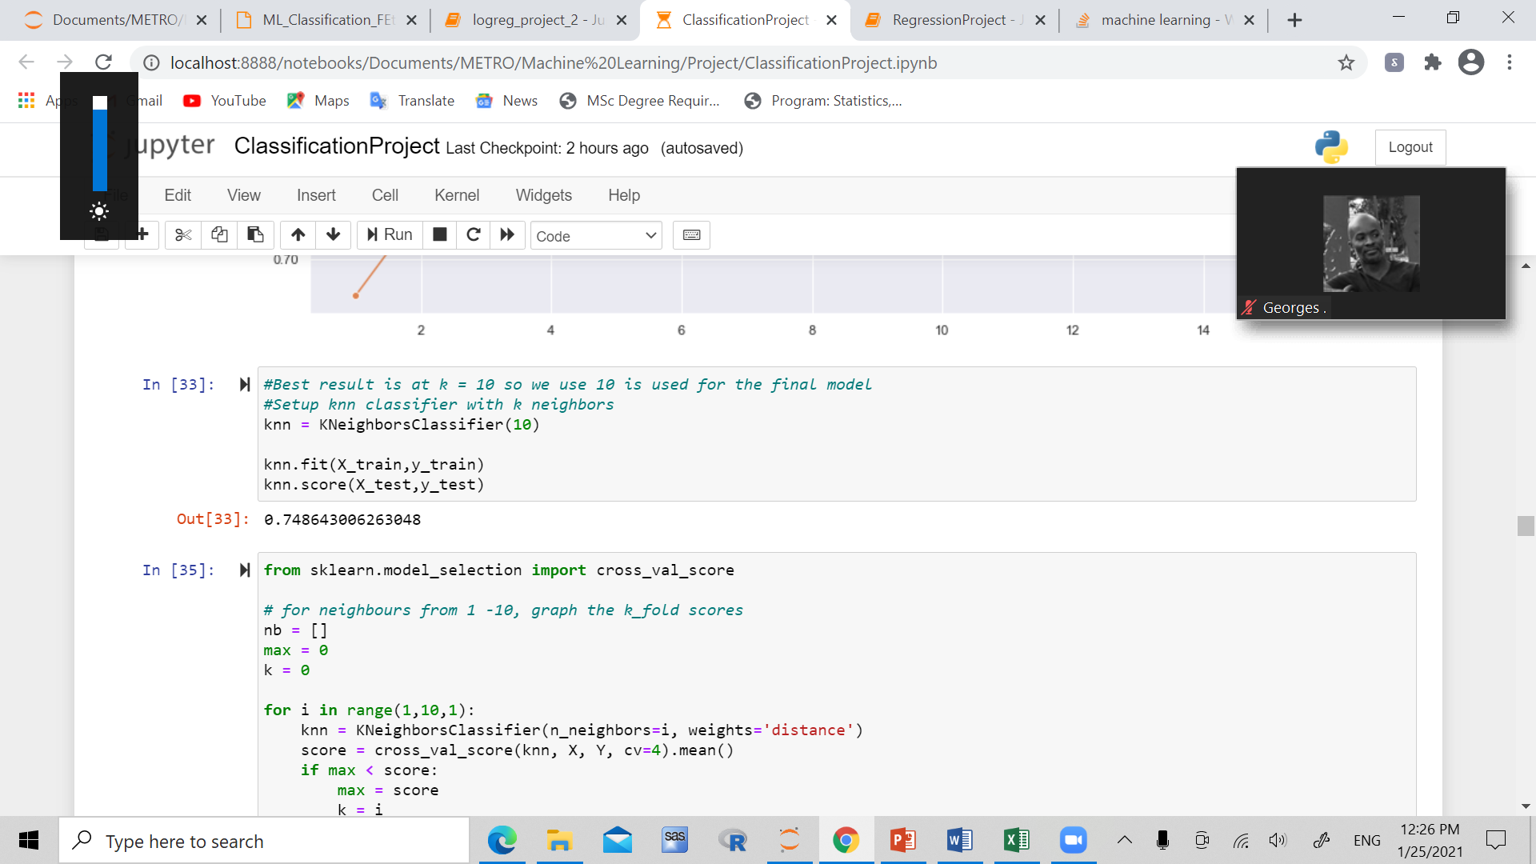
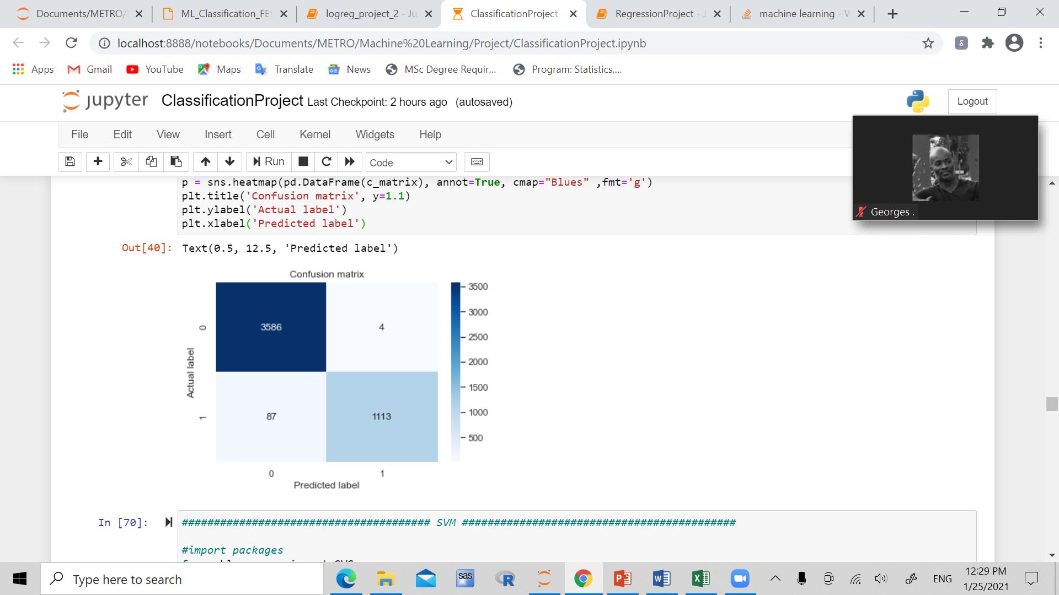
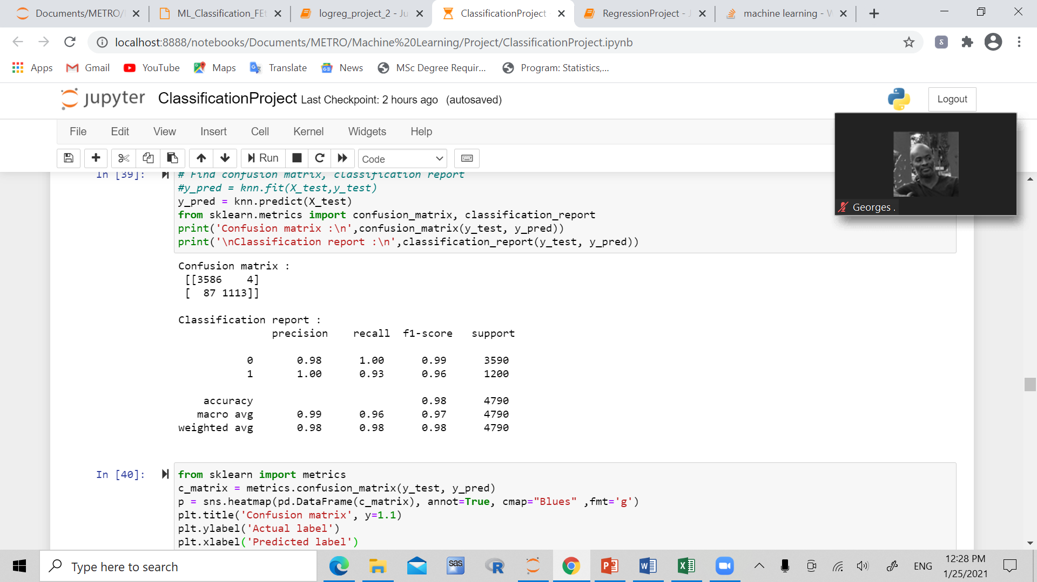

Slide 24
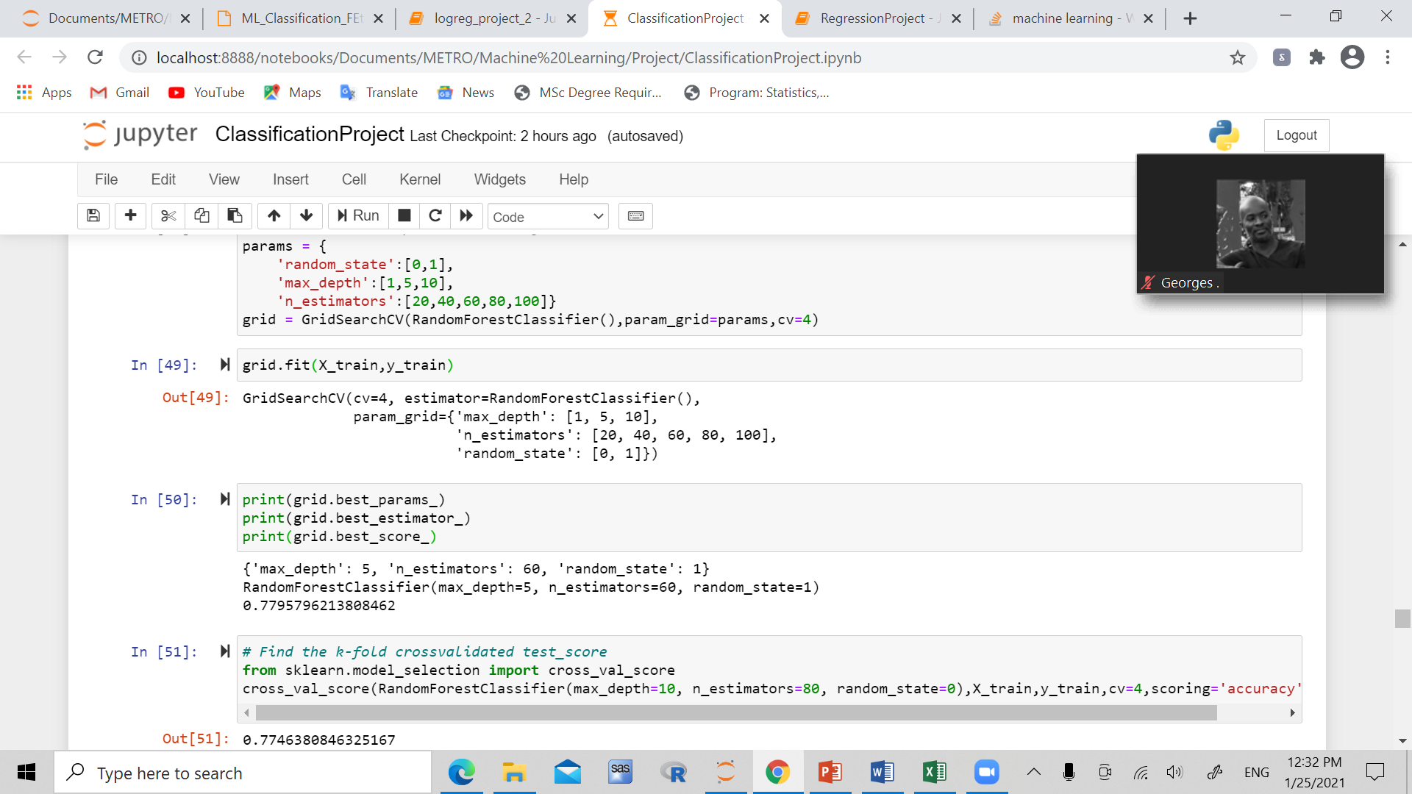
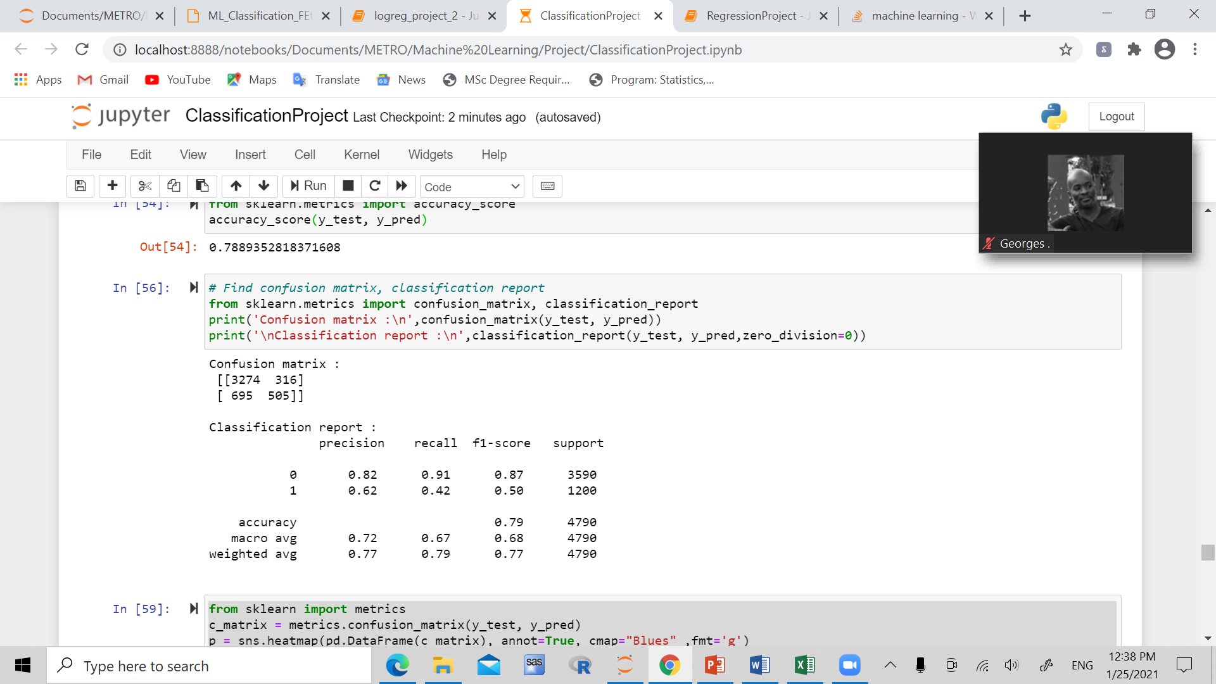
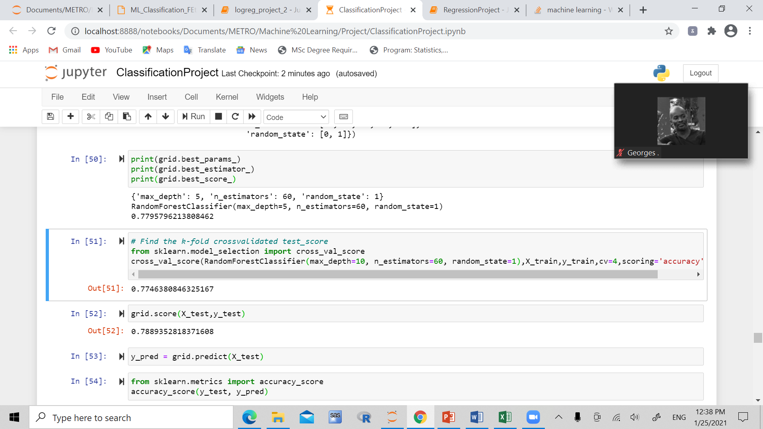
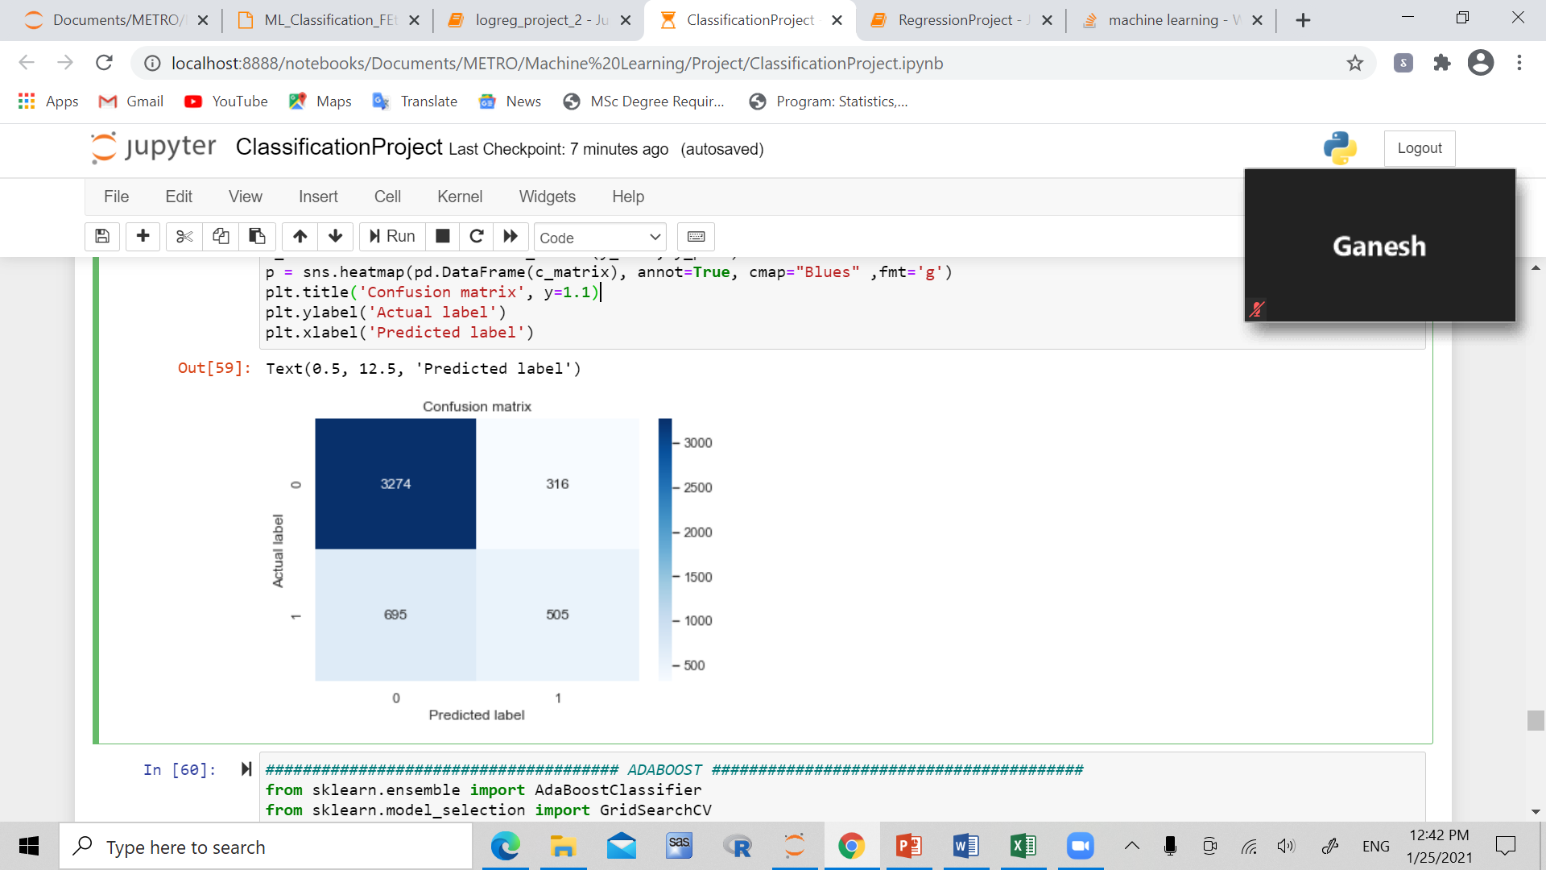
Random Forest

Slide 25
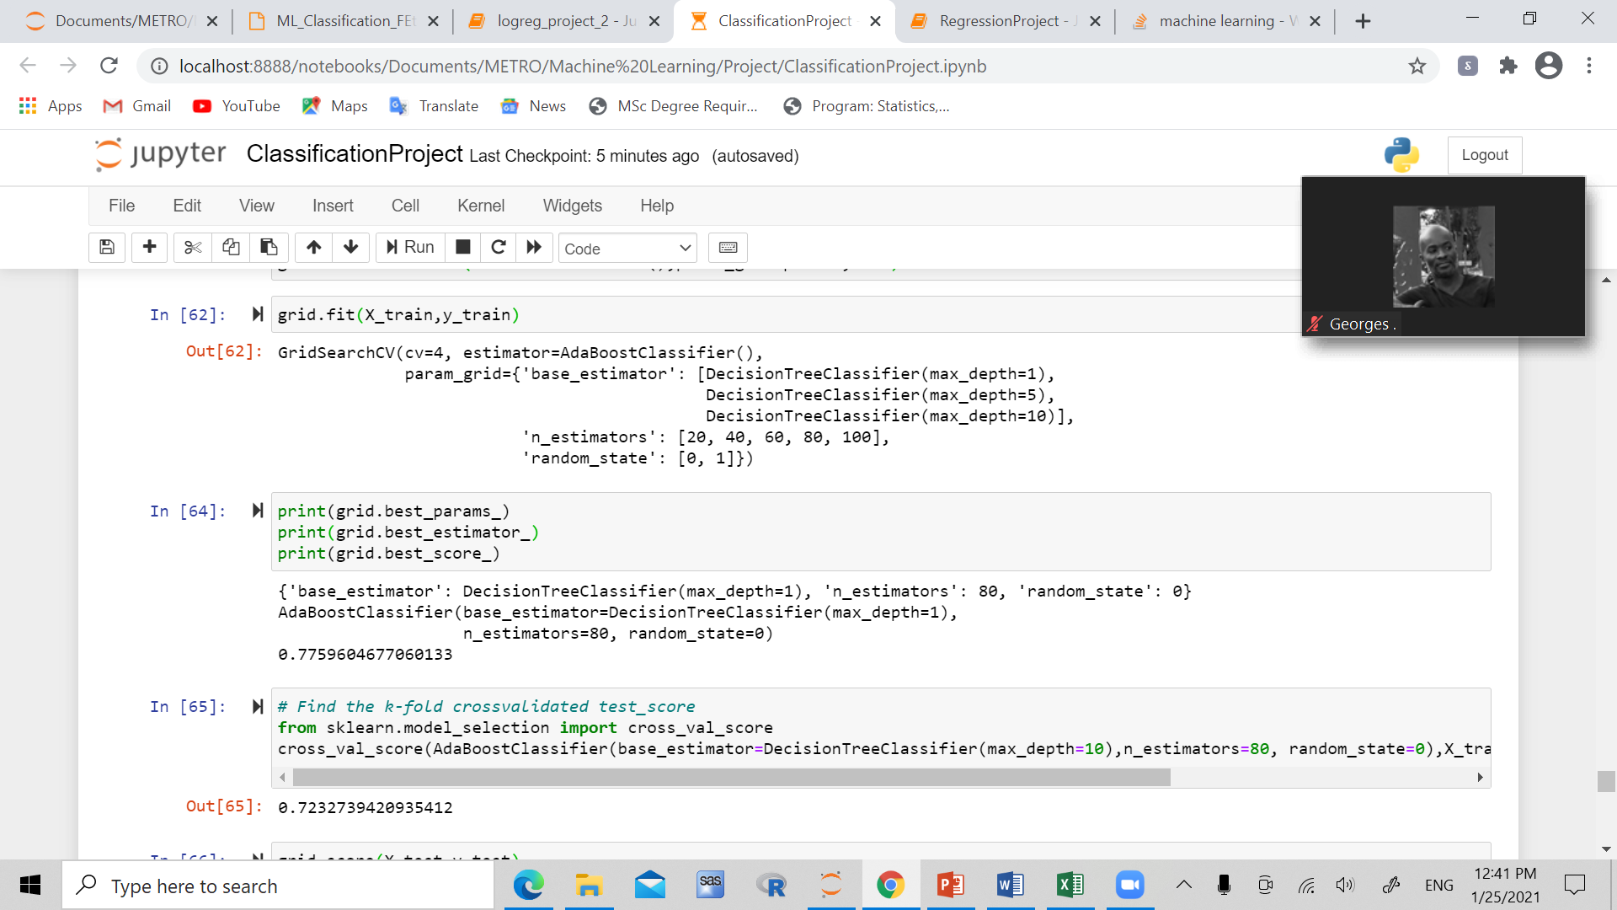
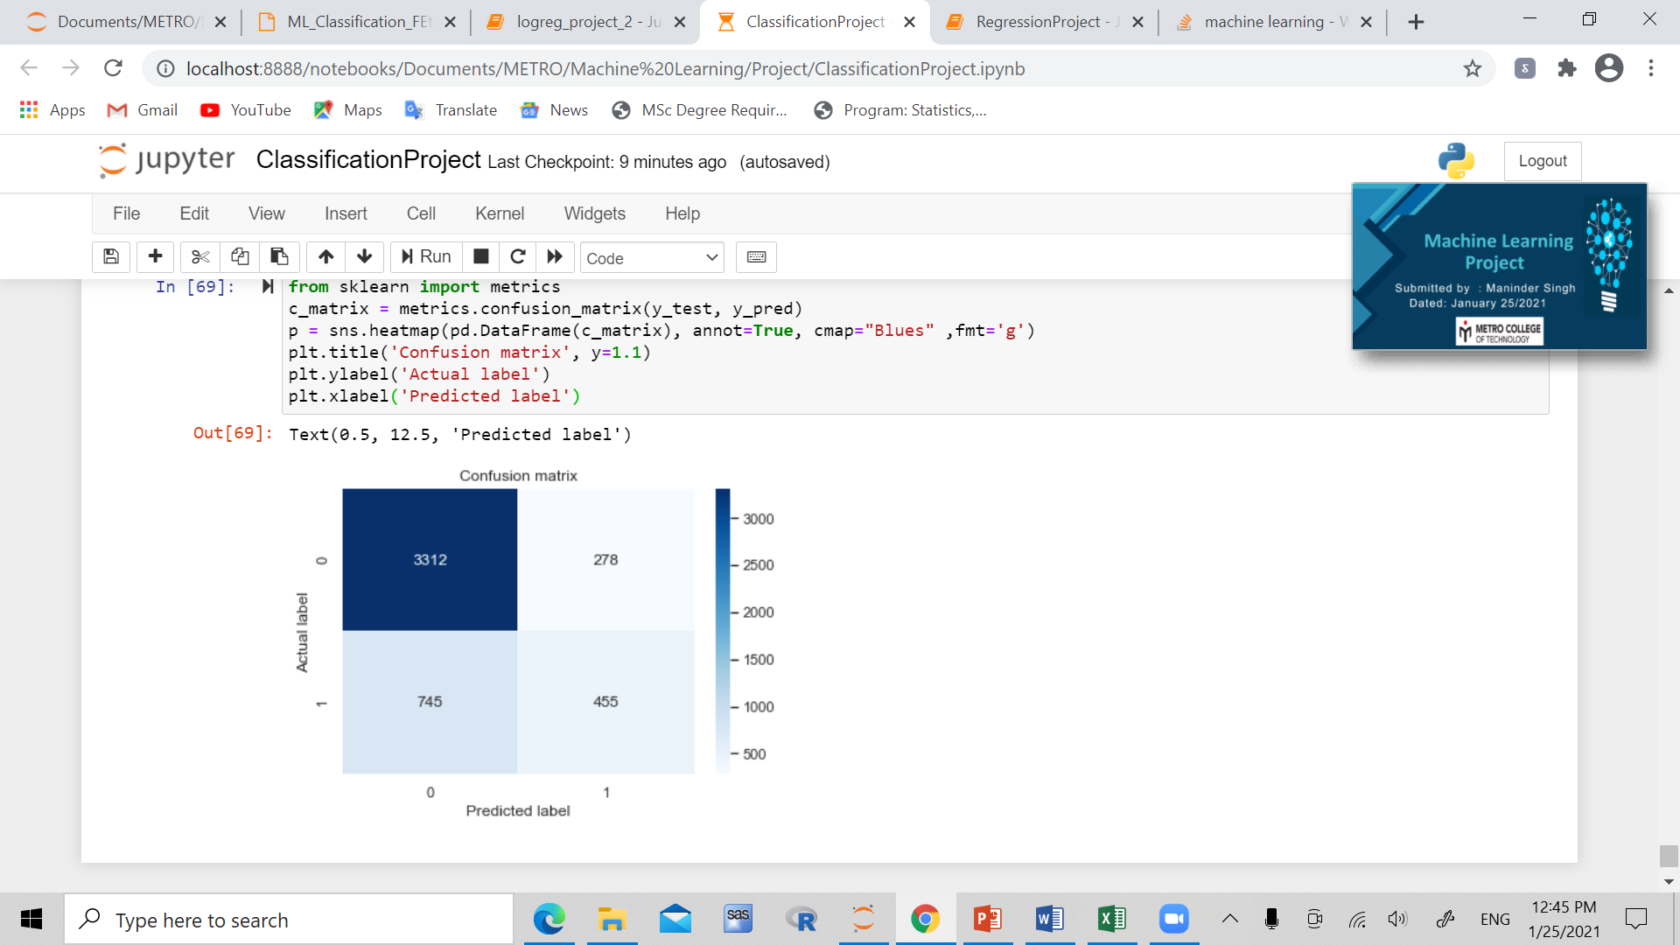
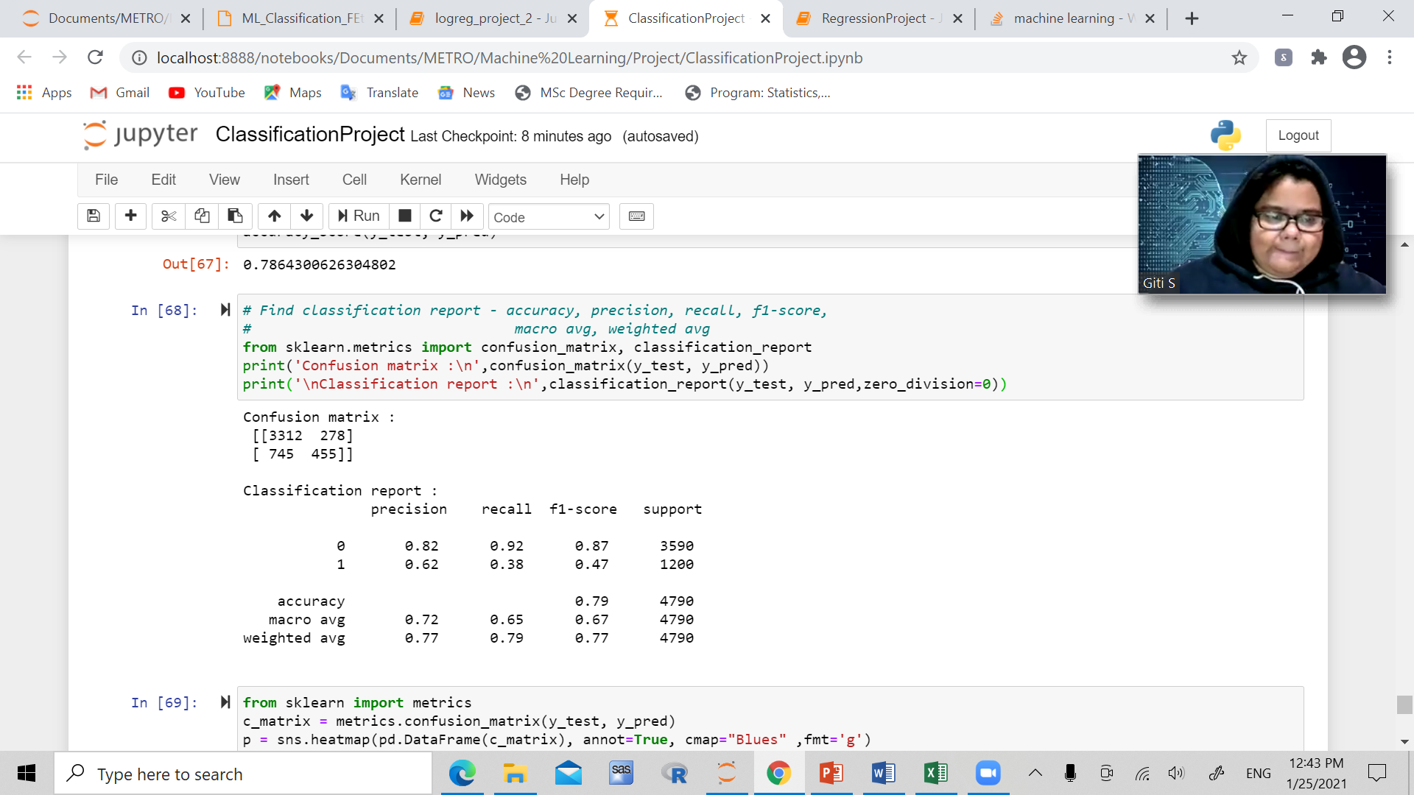
adaboost

Slide 26
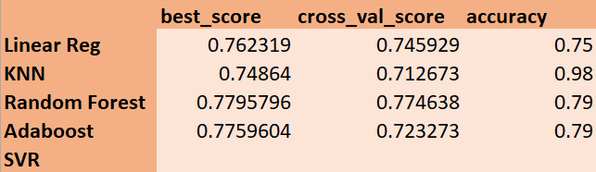
conclusion
KNN seems to have the highest accuracy, KNN should be the best model in this case

Slide 27
Thank you
Questions?

